Slide 1
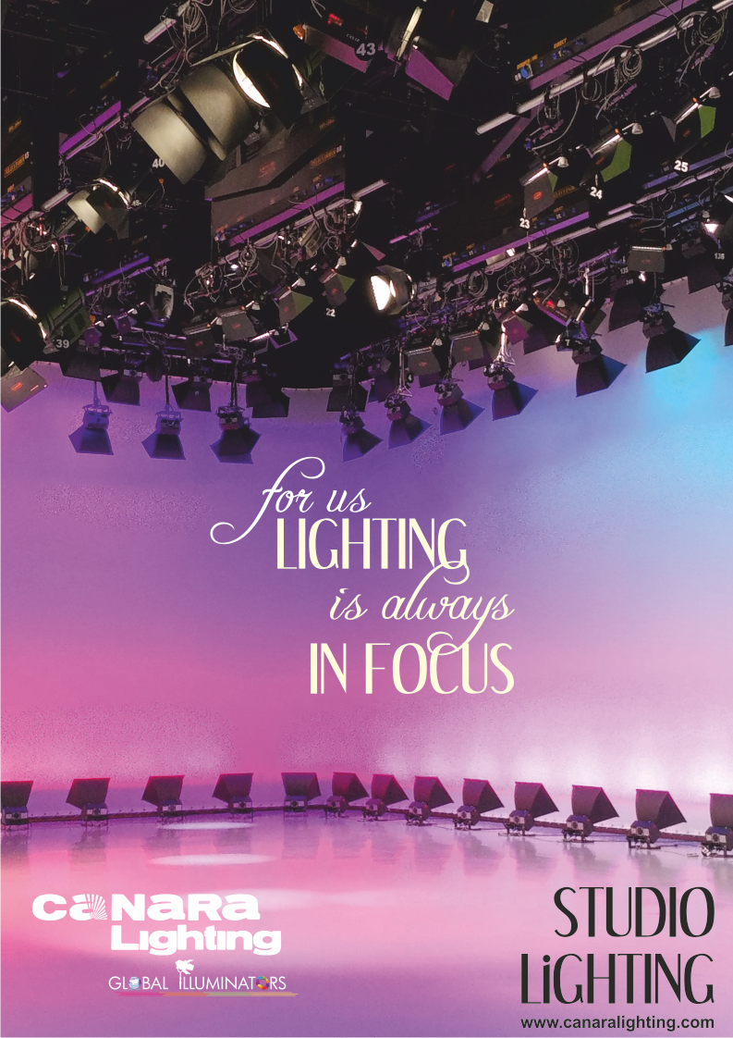

Slide 2
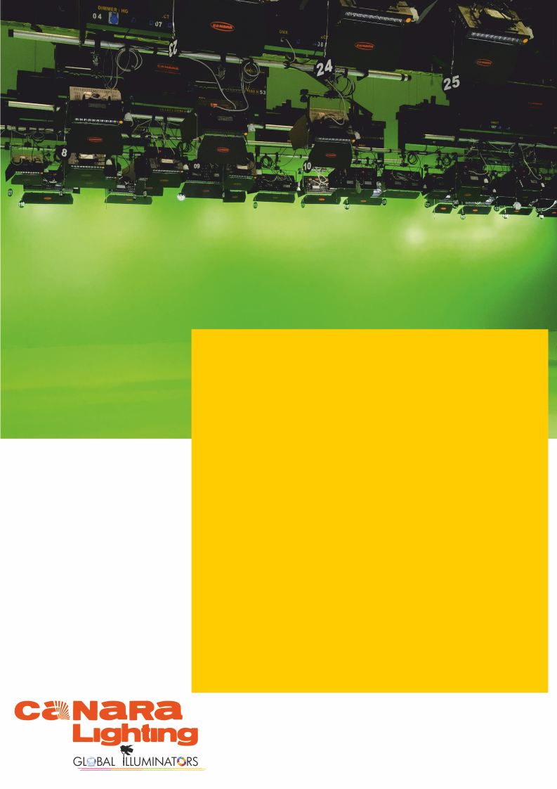



Canara Lighting is a pioneer in TV Studio lighting solutions with many prestigious projects executed over the past 50 years. Our extensive knowledge and expertise gained over the years makes us the ideal partner to work on projects from concept to commissioning with extensive training and after sales service. Our solutions are engineered to meet each customer's individual requirements. No matter the size of the studio or its unique requirement, Canara is your partner for the perfect lighting solution.
Canara Lighting has been serving the exacting and changing needs of our customers for the last 50 years. We have a world class manufacturing facility at Mangalore which is the largest in South Asia and includes R&D and testing facilities for lights and rigging. We truly follow the 'Make in India' concept in word and spirit. We provide turnkey lighting solutions for broadcasting studios, film studios, auditoriums, stadiums, sound and light shows, façade lighting and musical fountains. We provide world class products supported by effective service all over the country. All leading TV channels, auditoriums, convention centers are equipped with the knowledge and lighting solutions from Canara Lighting.
Contact us at :
info@canaralighting.com / contact@canaralighting.com
+91 95912 77022/ +91 95913 55022
www.canaralighting.com

Slide 3


TABLE OF CONTENTS
SL NO | PRODUCT DESCRIPTION | PAGE NO | REMARKS
STUDIO GRID & RIGGING SYSTEM
1 | FIXED PIPE GRID
2 | TRACK BEAM SYSTEM
3 | MOTORISED FLYGRIDS
4 | MOTORISED TELECLIMBERS
5 | MANUAL PANTOGRAPHS
6 | MOTORISED PANTOGRAPGHS
7 | EXTENDERS
STUDIO CURTAINS, CHROMA & CYCLORAMA
8 | PERIPHERAL CURTAIN TRACKS
9 | CHROMA SCREENS
10 | CYCLORAMA SCREENS
LIGHTING FIXTURES
11 | 90W, 5600K SOFT PANEL LIGHT
12 | 90W, 3200K SOFT PANEL LIGHT
13 | 90W, CCT TUNABLE SOFT PANEL LIGHT
14 | 150W, 5600K SOFT PANEL LIGHT
15 | 150W, 3200K SOFT PANEL LIGHT
16 | 150W, CCT TUNABLE SOFT PANEL LIGHT
17 | 180W, 5600K SOFT PANEL LIGHT
18 | 180W, 3200K SOFT PANEL LIGHT
INDEX-1

Slide 4
TABLE OF CONTENTS
SL NO | PRODUCT DESCRIPTION | PAGE NO | REMARKS
19 | 180W, CCT TUNABLE SOFT PANEL LIGHT
20 | 250W, 5600K SOFT PANEL LIGHT
21 | 250W, 3200K SOFT PANEL LIGHT
22 | 250W, CCT TUNABLE SOFT PANEL LIGHT
23 | 90W, 5600K LENS PANEL LIGHT
24 | 90W, 3200K LENS PANEL LIGHT
25 | 90W, CCT TUNABLE LENS PANEL LIGHT
26 | 150W, 5600K LENS PANEL LIGHT
27 | 150W, 3200K LENS PANEL LIGHT
28 | 150W, CCT TUNABLE LENS PANEL LIGHT
29 | 180W, 5600K LENS PANEL LIGHT
30 | 180W, 3200K LENS PANEL LIGHT
31 | 180W, CCT TUNABLE LENS PANEL LIGHT
32 | 250W, 5600K LENS PANEL LIGHT
33 | 250W, 3200K LENS PANEL LIGHT
34 | 250W, CCT TUNABLE LENS PANEL LIGHT
35 | 100W, 5600K FRESNEL SPOT LIGHT
36 | 100W, 3200K FRESNEL SPOT LIGHT
37 | 200W, 5600K FRESNEL SPOT LIGHT
38 | 200W, 3200K FRESNEL SPOT LIGHT
39 | 200W, CCT TUNABLE FRESNEL SPOT LIGHT
INDEX-2

Slide 5
TABLE OF CONTENTS
SL NO | PRODUCT DESCRIPTION | PAGE NO | REMARKS
40 | 200W, COLOR TUNABLE FRESNEL SPOT LIGHT
41 | 400W, 5600K FRESNEL SPOT LIGHT
42 | 400W, 3200K FRESNEL SPOT LIGHT
43 | 200W LED JAGLE PANEL LIGHT
44 | 400W LED JAGLE PANEL LIGHT
45 | 60W 5600K LED ENG LIGHT
46 | 60W 3200K LED ENG LIGHT
47 | 60W CCT TUNABLE LED ENG LIGHT
48 | 150W CYCLORAMA WASH LIGHT
49 | 200W, 3200K FIXED BEAM PROFILE SPOT LIGHT
50 | 200W, RGBW FIXED BEAM PROFILE SPOT LIGHT
51 | 200W, 3200K ZOOM PROFILE SPOT LIGHT
52 | 200W, RGBW ZOOM PROFILE SPOT LIGHT
53 | 300W, 3200K FIXED BEAM PROFILE SPOT LIGHT
54 | 300W, RGBW FIXED BEAM PROFILE SPOT LIGHT
52 | 300W, 3200K ZOOM PROFILE SPOT LIGHT
53 | 300W, RGBW ZOOM PROFILE SPOT LIGHT
54 | 54 X 3W RGBW PAR LIGHT
55 | 54 X 3W 5600K PAR LIGHT
56 | 54 X 3W 3200K PAR LIGHT
57 | 54 X 3W BI COLOR PAR LIGHT
INDEX-3

Slide 6
TABLE OF CONTENTS
SL NO | PRODUCT DESCRIPTION | PAGE NO | REMARKS
58 | 18 X 10W RGBW PAR LIGHT
59 | 150W CHROMA WASH LIGHT
60 | 20W 3200K MINI PROFILE LIGHT
SPLITTERS & CONSOLE
54 | 8 CHANNEL RDM DMX AMPLIFIER SPLITTER
55 | 96 FIXTURE NON RDM LIGHTING CONSOLE
56 | 96 FIXTURE RDM LIGHTING CONSOLE
57 | 120 FIXRURE RDM LIGHTING CONSOLE
58 | 200 FIXTURE RDM LIGHTING CONSOLE
59 | 512 FIXTURE NON RDM LIGHTING CONSOLE
60 | 96 FIXTURE NON RDM LIGHTING CONSOLE
61 | 48 FIXTURE TOUCH SCREEN LIGHTING CONSOLE
62 | 96 FIXTURE TOUCH SCREEN LIGHTING CONSOLE
63 | 2048 FIXTURE TOUCH SCREEN LIGHTING CONSOLE
MISCELLANIOUS ITEMS
64 | POWER JUNCTION BOXES
65 | SIGNAL JUNCTION BOXES
66 | CABLE TRAYS
67 | POWER DISTRIBUTION PANELS
52 | MOTOR CONTROL PANELS
53 | MS PIPE, C TRACK & SUSPENDERS
INDEX-4

Slide 7

Canara fixed pipe grid offers a wide range of design options to suspend the lighting fixtures in Theaters, Auditoriums and Convention centers, Studios, Production House, Film Institutions.
FIXED PIPE GRID
SPECIAL FEATURES
Designed with the highest standards of construction using 40NB MS tubes duly epoxy polyester powder coated in black matt texture finish.
Pipe grid is constructed in different sizes: 1X1, 1.2X1.2, 1.5X1.5, 2X2 Mrt. The grid is suspended using M12 threaded rod suspenders or angle suspenders.
Pipe grid is permanently mounted approx. 2 ft. below ceiling and lighting fixtures can be hung, adjusted and maintained from floor using clamps, flexi-adaptors and pole operated yoke systems of light fixtures.
TECHNICAL SPECIFICATIONS
Standard Dimensions : 1X1 Meter, 1.2X1.2 Meter, 1.5X1.5 Meter, 2X2 Meter, Customizable,
Safe Working Load : 80 kg
Pipe Specification : 40 Nominal Bore, 2mm / 3mm thick, 48mm Outer diameter
7 Tank chemical treatment to keep away from rust
PRODUCT CODES : FPG-1, FPG-1.2, FPG-1.5, FPG-2
Design, Manufacture and Tested at Canara Lighting Industries Pvt. Ltd. Mulky-Kinnigoli Airport Road Mangalore 574 150. India.
1 of 1
We innovate continuously to improve specifications, design, manufacturing techniques etc. hence technical data and offerings are subject to change without prior notice. Individual test results may vary. Results based on a representative sample in Canara inventory.

Slide 8
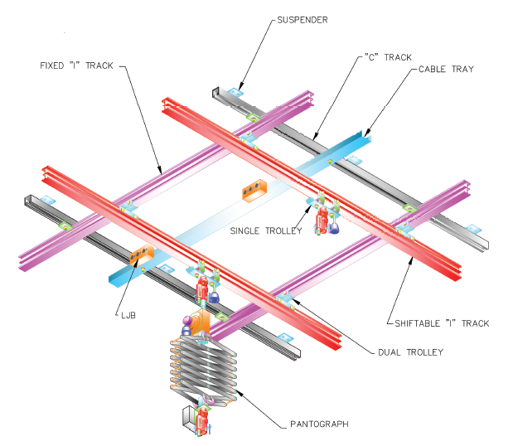
Canara fixed pipe grid offers a wide range of design options to suspend the lighting fixtures in Theaters, Auditoriums and Convention centers, Studios, Production House, Film Institutions.
TRACK BEAM GRID
SPECIAL FEATURES
Designed with the highest standards of construction using Aluminium I-tracks duly epoxy polyester powder coated in black matt texture finish.
Track grid is constructed in different sizes: 1X1, 1.2X1.2, 1.5X1.5, 2X2 Mrt. The grid is suspended using M12 threaded rod suspenders or angle suspenders.
Pipe grid is permanently mounted approx. 2 ft. below ceiling and lighting fixtures can be hung, adjusted and maintained from floor using clamps, flexi-adaptors and pole operated yoke systems of light fixtures.
TECHNICAL SPECIFICATIONS
Standard Dimensions : 1X1 Meter, 1.2X1.2 Meter, 1.5X1.5 Meter, 2X2 Meter, Customizable,
Safe Working Load : 80 kg
Swivel trolley for flexible movement of Tracks & Medium duty track trolleys for Light positioning
7 Tank chemical treatment to keep away from rust
PRODUCT CODES : TBG
Design, Manufacture and Tested at Canara Lighting Industries Pvt. Ltd. Mulky-Kinnigoli Airport Road Mangalore 574 150. India.
1 of 1
We innovate continuously to improve specifications, design, manufacturing techniques etc. hence technical data and offerings are subject to change without prior notice. Individual test results may vary. Results based on a representative sample in Canara inventory.

Slide 9
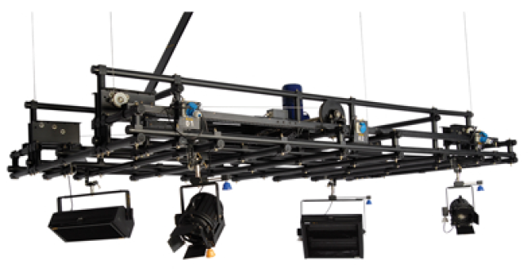
Motorized Flygrid combines innovative design with the highest standards of construction and ease of installation for payloads up to 180Kg. Motorized Flygrid incorporates the luminaire suspension pipe, the relevant safety switches luminaire power outlet, and a worm geared motor raising and lowering the unit. To reduce the costs of the site installation and simplify it, the Hoist is supplied with pre-mounted structure to which the four wire ropes, the flip-flop power cable tray and electrical terminal box are already attached.
MOTORIZED FLYGRID
SPECIAL FEATURES
EFFICIENCY AND OPERATING COSTS : The Self Climbing hoist is ideal for the raising and lowering of lighting instruments along with their associated circuits and dimmers. The ability to lower the lighting batten to any positions within the set area, increases the efficiency of the operations by allowing easy access to the lighting instruments for aiming, focusing and the handling of the lighting fixtures, This product can be either installed in permanent fixed positions directly to the I-beam sub-structure of the building, or to any supporting grid
Certifications : CE
MECHANICAL : A special frame maintains a clear separation between the moving parts (mechanical elements in motion), like steel ropes, winding discs, diverter pulleys, load sensor mechanisms) and the electrical components (electrical wiring, motor switch-gears, safety micro switches, electrical and data sockets, travel limit device). The separation of these elements allows maintenance procedures to be performed safely and the electrical components maintained in a clean environment.
1 of 2
We innovate continuously to improve specifications, design, manufacturing techniques etc. hence technical data and offerings are subject to change without prior notice. Individual test results may vary. Results based on a representative sample in Canara inventory.

Slide 10
STANDARD SAFETY FEATURES
SAFETY : Approved by the testing authorities of the European standards. These Standards are directly associated with safety of suspensions systems mounted above an assembly of people. The safety features incorporated into the Canara motorised Flygrid, a dynamic self sustaining worm-geared set motor with DC brake and screw helix angle less than 4 degrees to prevent back winding, two safety micro switches one for the top limit plus an extra emergency safety switch and one for the bottom limit plus an extra emergency safety switch and over load and slack line detection on each wire rope.
OPERATIONAL : The Self-Climbing Hoist is capable of lifting a safe working load (SWL) of 180 Kg, plus the self-weight of the hoist, which is based on the travel distance and the optional features incorporated into the hoist. The maximum travel distance is 42 feet /13 meters (Standard) or More as per the requirement.
MOTORIZED FLYGRID
TECHNICAL SPECIFICATIONS
Electric Motor : 0.75 HP/ 1.0 HP / 1.5 HP, 3 Phase AC Motor with DC Brake
Gear Box : Specially designed single stage worm reduction
Self Weight : >250 kg
Safe Working Load : 180kg to 200kg
Max Travel Distance : upto 13 Meter (Standard) or More as per the requirement
Lift speed : 5 to 7 Meter / Minute
Minimum Collapse Height : 1.4 Meter
Safety : Two safety micro switches each for the Top and the Bottom limit, Slack wire safety, Over load protection
Lifting rope : 4 Nos 4mm diameter anti-rotating GI ropes
Finish : Epoxy polyester powder coated in matt texture finish
Control : DOL with forward and reverse control (Standard approach )
Optional Control : VFD / Wireless / HMI / Hand-held Pendent
Grid Size : 2X2, 2.5x2.5, 3X3, 4X4 Meter (Customizable as per site requirements)
PRODUCT CODES : MFG 22, MFG 252, MFG 2525, MFG 253, MFG 32, MFG 33
Design, Manufacture and Tested at Canara Lighting Industries Pvt. Ltd. Mulky-Kinnigoli Airport Road Mangalore 574 150. India.
2 of 2
We innovate continuously to improve specifications, design, manufacturing techniques etc. hence technical data and offerings are subject to change without prior notice. Individual test results may vary. Results based on a representative sample in Canara inventory.

Slide 11
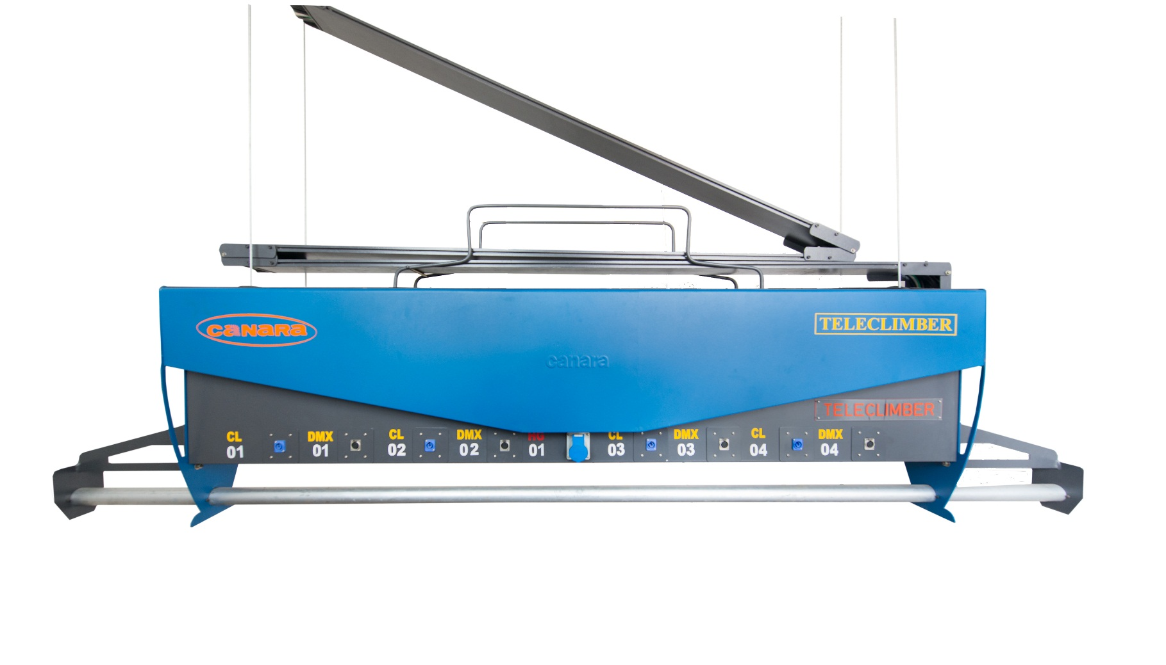
Motorized Teleclimber combines innovative design with the highest standards of construction and ease of installation for payloads up to 140Kg. Motorized Teleclimber incorporates the luminaire suspension pipe, the relevant safety switches luminaire power outlet, and a worm geared motor raising and lowering the unit. To reduce the costs of the site installation and simplify it, the Hoist is supplied with pre-mounted structure to which the four wire ropes, the flip-flop power cable tray and electrical terminal box are already attached.
MOTORIZED TELECLIMBER
SPECIAL FEATURES
EFFICIENCY AND OPERATING COSTS : The Self Climbing hoist is ideal for the raising and lowering of lighting instruments along with their associated circuits and dimmers. The ability to lower the lighting batten to any positions within the set area, increases the efficiency of the operations by allowing easy access to the lighting instruments for aiming, focusing and the handling of the lighting fixtures, This product can be either installed in permanent fixed positions directly to the I-beam sub-structure of the building, or to any supporting grid
Certifications : CE
MECHANICAL : A special frame maintains a clear separation between the moving parts (mechanical elements in motion), like steel ropes, winding discs, diverter pulleys, load sensor mechanisms) and the electrical components (electrical wiring, motor switch-gears, safety micro switches, electrical and data sockets, travel limit device). The separation of these elements allows maintenance procedures to be performed safely and the electrical components maintained in a clean environment.
1 of 2
We innovate continuously to improve specifications, design, manufacturing techniques etc. hence technical data and offerings are subject to change without prior notice. Individual test results may vary. Results based on a representative sample in Canara inventory.

Slide 12
STANDARD SAFETY FEATURES
SAFETY : Approved by the testing authorities of the European standards. These Standards are directly associated with safety of suspensions systems mounted above an assembly of people. The safety features incorporated into the Canara motorised teleclimber, a dynamic self sustaining worm-geared set motor with DC brake and screw helix angle less than 4 degrees to prevent back winding, two safety micro switches one for the top limit plus an extra emergency safety switch and one for the bottom limit plus an extra emergency safety switch and over load and slack line detection on each wire rope.
OPERATIONAL : The Self-Climbing Hoist is capable of lifting a safe working load (SWL) of 140 Kg, plus the self-weight of the hoist, which is based on the travel distance and the optional features incorporated into the hoist. The maximum travel distance is 42 feet /13 meters.
MOTORIZED TELECLIMBER
TECHNICAL SPECIFICATIONS
Electric Motor : 0.75 HP/ 1.0 HP / 1.5 HP, 3 Phase AC Motor with DC Brake
Gear Box : Specially designed single stage worm reduction
Self Weight : > 145 kg
Safe Working Load : 100kg to 145kg
Max Travel Distance : upto 13 Meter
Lift speed : 5 to 7 Meter / Minute
Minimum Collapse Height : 1.4 Meter
Safety : Two safety micro switches each for the Top and the Bottom limit, Slack wire safety, Over load protection
Lifting rope : 4 Nos 4mm diameter anti-rotating GI ropes
Finish : Epoxy polyester powder coated in matt texture finish
Control : DOL with forward and reverse control (Standard approach )
Optional Control : VFD / Wireless / HMI / Hand-held Pendent
Winch Length : 2.5 Meter to 5 Meter (Customizable as per site requirements)
PRODUCT CODES : TCH-CEE, TCH-IEC, TCH-CPL, TCH-BCH, TCH-CYC CEE, TCH-CYC CPL, TCH-CYC BCH, TCH-CYC IEC, TCH-CD, TCH-ID, TCH-BD, TCH-CPD, TCH-CID, TCH-BID, TCH-CPID, TCH-CB, TCH-IB, TCH-BB, TCH-CPB, TCH-CIB, TCH-BIB, TCH-CPIB
Design, Manufacture and Tested at Canara Lighting Industries Pvt. Ltd. Mulky-Kinnigoli Airport Road Mangalore 574 150. India.
2 of 2
We innovate continuously to improve specifications, design, manufacturing techniques etc. hence technical data and offerings are subject to change without prior notice. Individual test results may vary. Results based on a representative sample in Canara inventory.

Slide 13

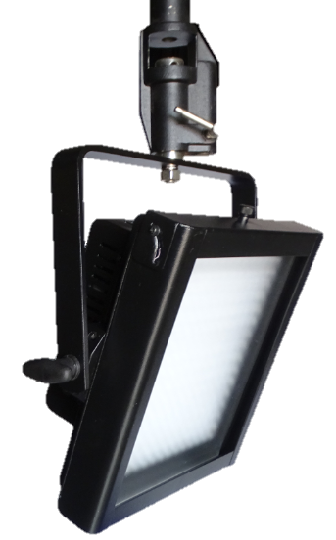
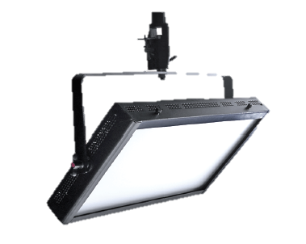
90W – 5600K
Canara LED Panel series LED lighting system has been specifically developed for film and video applications that demand extremely color-accurate, high quality light. Utilizing proprietary, state-of-the-art, daylight balanced LEDs, Canara LED Panel creates a high volume of broad spectrum white light, combined with an electronic flicker-free dimmable power supply unit to create a powerful yet economical LED soft light. Perfect for TV studio, Production Studios, Film Recordings & Documentaries etc.,
SOFT PANEL LIGHT
MODEL : CAN LED T
SPECIAL FEATURES
Delivers the High-volume light output.
Double accessories slot for inserting color Filters, Barndoor and other accessories with lock retaining clip.
Fully RDM Compliant when in DMX mode
Electronic universal power supply 100-260 V AC, 50/60 Hz.
Non-glare, diffuser provides uniform, single source light.
Efficient power and thermal management delivers low power consumption and enhanced reliability.
Fanless design perfect for studio application
All metal construction.
No light spill to distract audiences or performers.
Available with pole operated yoke.
TECHNICAL SPECIFICATIONS
LIGHT SOURCE
Lamp : SMD LED ARRAY
Color temperature (CCT) : 5600K
CRI : > 95, TLCI: > 95, R9 Value: > 95
Color Quality Scale (CQS) : > 95
Lamp life : L70 >50000 Hours @ 55°C
OPTICAL SYSTEM
Beam Angle : 100°
Acrylic milky diffuser 2 mm /3mm thick provides eye pleasant light output.
1 of 3
We innovate continuously to improve specifications, design, manufacturing techniques etc. hence technical data and offerings are subject to change without prior notice. Individual test results may vary. Results based on a representative sample in Canara inventory.

Slide 14
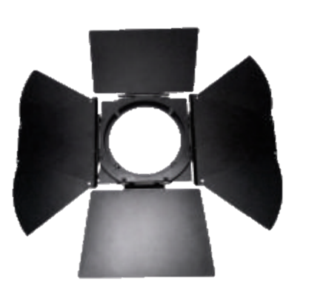
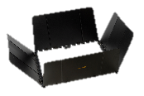

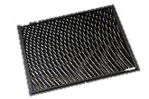


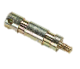
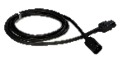
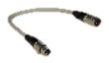
90W – 5600K
ELECTRICAL
Flicker free auto-ranging electronic switch mode power supply 100~240 VAC Nominal, 50/60 Hz
0 to 100% 8 Bit Linear Dimming
Power Factor ≥0.95 @ 230V 50Hz
Main fuse - T12A-250V
Max mains current 3.7A@drawn 1A @ 230V 50Hz
Max LED current drawn 54V DC
Power supply cable: 2 meter 3 Core 1Sq mm FRLS grade PVC cable with IEC Plug
ACCESSORIES
 | 8 leaf Barndoor
 | 4 leaf Barndoor
 | Softbox
 | Honey comb screens
 | Filter frame
 | Clamps & Spuds
 | Cables
SOFT PANEL LIGHT
CONTROL
On board Control with 5 No's High Precision Membrane switch with 7 segment display for easy to read status.
USITT DMX512A (RDM Compatible) Control Protocol.
5 pin locking XLR Chasis mount DMX in & through connections
8 bit DMX control, extra soft dimming, for theatrical & Studio use.
DMX CHART
1 Channel Mode : Dimmer, 0-100%
PHYSICAL
Aluminum laser cut body
Passive Cooling system with large heatsink, no noise, perfect for TV studios & theatres
Aluminium yoke
Available in Manual and Pole operated system for Pan, Tilt and Focus.
Epoxy polyester powder coated matt black finish (RAL – 9005) (Customizable as per requirements)
IP Rating : IP20
WEIGHT & DIMENTIONS
 | Normal Yoke | POS Yoke | Unit
Weight | 7.6 | 9.8 | Kg
Length | 370 |  | mm
Width | 250 |  | mm
Height | 295 |  | mm
2 of 3
We innovate continuously to improve specifications, design, manufacturing techniques etc. hence technical data and offerings are subject to change without prior notice. Individual test results may vary. Results based on a representative sample in Canara inventory.

Slide 15
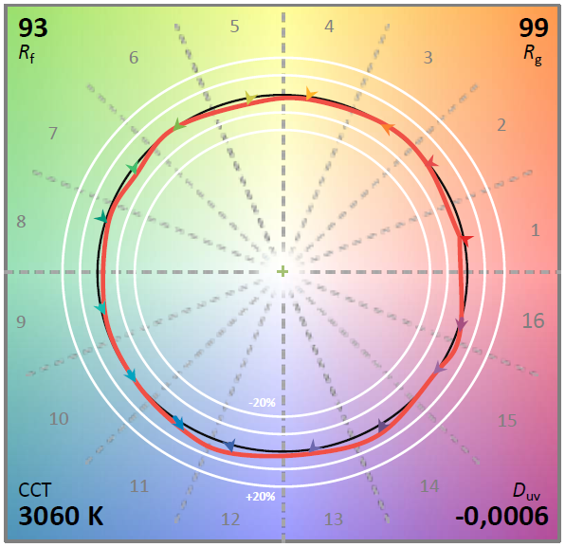
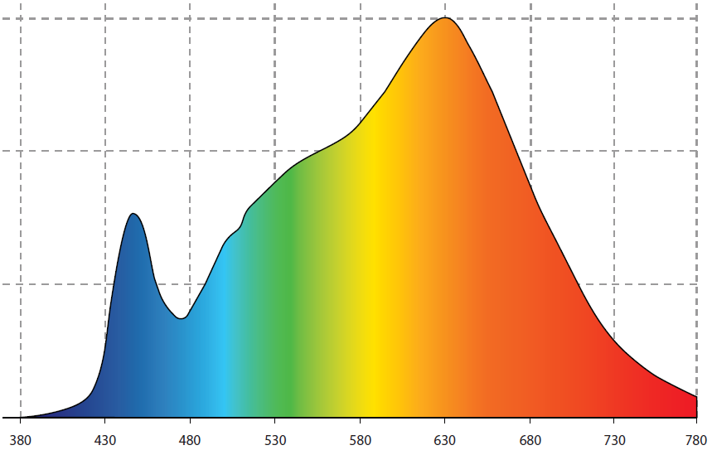
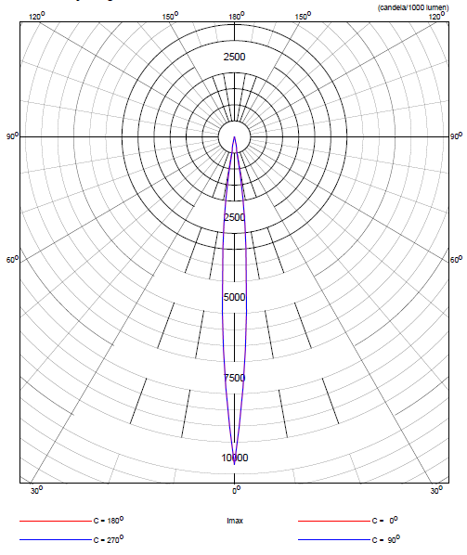
90W – 5600K
PHOTOMETRIC PERFORMANCE
TM-30
SPECTRUM
SOFT PANEL LIGHT
POLAR DIAGRAM – FLOOD
Photometric Data - Flood @ 100 Degrees - 5600K
Throw Distance | (m) | 1 | 1.5 | 2 | 2.5 | 3
 | (ft) | 3.28 | 4.92 | 6.56 | 8.20 | 9.84
Beam Diameter | (m) | 2.39 | 3.58 | 4.77 | 5.96 | 7.16
 | (ft) | 7.84 | 11.75 | 15.65 | 19.55 | 23.49
Illumination | (lux) | 2000 | 889 | 500 | 320 | 222
 | (fc) | 186 | 83 | 46 | 30 | 21
3 of 3
Design, Manufacture and Tested at Canara Lighting Industries Pvt. Ltd. Mulky-Kinnigoli Airport Road Mangalore 574 150. India.
We innovate continuously to improve specifications, design, manufacturing techniques etc. hence technical data and offerings are subject to change without prior notice. Individual test results may vary. Results based on a representative sample in Canara inventory.

Slide 16
90W – 3200K
Canara LED Panel series LED lighting system has been specifically developed for film and video applications that demand extremely color-accurate, high quality light. Utilizing proprietary, state-of-the-art, daylight balanced LEDs, Canara LED Panel creates a high volume of broad spectrum white light, combined with an electronic flicker-free dimmable power supply unit to create a powerful yet economical LED soft light. Perfect for TV studio, Production Studios, Film Recordings & Documentaries etc.,
SOFT PANEL LIGHT
MODEL : CAN LED T
SPECIAL FEATURES
Delivers the High-volume light output.
Double accessories slot for inserting color Filters, Barndoor and other accessories with lock retaining clip.
Fully RDM Compliant when in DMX mode
Electronic universal power supply 100-260 V AC, 50/60 Hz.
Non-glare, diffuser provides uniform, single source light.
Efficient power and thermal management delivers low power consumption and enhanced reliability.
Fanless design perfect for studio application
All metal construction.
No light spill to distract audiences or performers.
Available with pole operated yoke.
TECHNICAL SPECIFICATIONS
LIGHT SOURCE
Lamp : SMD LED ARRAY
Color temperature (CCT) : 5600K
CRI : > 95, TLCI: > 95, R9 Value: > 95
Color Quality Scale (CQS) : > 95
Lamp life : L70 >50000 Hours @ 55°C
OPTICAL SYSTEM
Beam Angle : 100°
Acrylic milky diffuser 2 mm /3mm thick provides eye pleasant light output.
1 of 3
We innovate continuously to improve specifications, design, manufacturing techniques etc. hence technical data and offerings are subject to change without prior notice. Individual test results may vary. Results based on a representative sample in Canara inventory.

Slide 17
90W – 3200K
ELECTRICAL
Flicker free auto-ranging electronic switch mode power supply 100~240 VAC Nominal, 50/60 Hz
0 to 100% 8 Bit Linear Dimming
Power Factor ≥0.95 @ 230V 50Hz
Main fuse - T12A-250V
Max mains current 3.7A@drawn 1A @ 230V 50Hz
Max LED current drawn 54V DC
Power supply cable: 2 meter 3 Core 1Sq mm FRLS grade PVC cable with IEC Plug
ACCESSORIES
 | 8 leaf Barndoor
 | 4 leaf Barndoor
 | Softbox
 | Honey comb screens
 | Filter frame
 | Clamps & Spuds
 | Cables
SOFT PANEL LIGHT
CONTROL
On board Control with 5 No's High Precision Membrane switch with 7 segment display for easy to read status.
USITT DMX512A (RDM Compatible) Control Protocol.
5 pin locking XLR Chasis mount DMX in & through connections
8 bit DMX control, extra soft dimming, for theatrical & Studio use.
DMX CHART
1 Channel Mode : Dimmer, 0-100%
PHYSICAL
Aluminum laser cut body
Passive Cooling system with large heatsink, no noise, perfect for TV studios & theatres
Aluminium yoke
Available in Manual and Pole operated system for Pan, Tilt and Focus.
Epoxy polyester powder coated matt black finish (RAL – 9005) (Customizable as per requirements)
IP Rating : IP20
WEIGHT & DIMENTIONS
 | Normal Yoke | POS Yoke | Unit
Weight | 7.6 | 9.8 | Kg
Length | 370 |  | mm
Width | 250 |  | mm
Height | 295 |  | mm
2 of 3
We innovate continuously to improve specifications, design, manufacturing techniques etc. hence technical data and offerings are subject to change without prior notice. Individual test results may vary. Results based on a representative sample in Canara inventory.

Slide 18
90W – 3200K
PHOTOMETRIC PERFORMANCE
TM-30
SPECTRUM
SOFT PANEL LIGHT
POLAR DIAGRAM – FLOOD
Photometric Data - Flood @ 100 Degrees - 5600K
Throw Distance | (m) | 1 | 2 | 3 | 5 | 7
 | (ft)
Beam Diameter | (m)
 | (ft)
Illumination | (lux) | 99999 | 99999 | 99999 | 99999 | 99999
 | (fc)
3 of 3
Design, Manufacture and Tested at Canara Lighting Industries Pvt. Ltd. Mulky-Kinnigoli Airport Road Mangalore 574 150. India.
We innovate continuously to improve specifications, design, manufacturing techniques etc. hence technical data and offerings are subject to change without prior notice. Individual test results may vary. Results based on a representative sample in Canara inventory.

Slide 19
90W – CCT TUNABLE
Canara LED Panel series LED lighting system has been specifically developed for film and video applications that demand extremely color-accurate, high quality light. Utilizing proprietary, state-of-the-art, daylight balanced LEDs, Canara LED Panel creates a high volume of broad spectrum white light, combined with an electronic flicker-free dimmable power supply unit to create a powerful yet economical LED soft light. Perfect for TV studio, Production Studios, Film Recordings & Documentaries etc.,
SOFT PANEL LIGHT
MODEL : CAN LED T
SPECIAL FEATURES
Delivers the High-volume light output.
Double accessories slot for inserting color Filters, Barndoor and other accessories with lock retaining clip.
Fully RDM Compliant when in DMX mode
Electronic universal power supply 100-260 V AC, 50/60 Hz.
Non-glare, diffuser provides uniform, single source light.
Efficient power and thermal management delivers low power consumption and enhanced reliability.
Fanless design perfect for studio application
All metal construction.
No light spill to distract audiences or performers.
Available with pole operated yoke.
TECHNICAL SPECIFICATIONS
LIGHT SOURCE
Lamp : SMD LED ARRAY
Color temperature (CCT) : 5600K
CRI : > 95, TLCI: > 95, R9 Value: > 95
Color Quality Scale (CQS) : > 95
Lamp life : L70 >50000 Hours @ 55°C
OPTICAL SYSTEM
Beam Angle : 100°
Acrylic milky diffuser 2 mm /3mm thick provides eye pleasant light output.
1 of 3
We innovate continuously to improve specifications, design, manufacturing techniques etc. hence technical data and offerings are subject to change without prior notice. Individual test results may vary. Results based on a representative sample in Canara inventory.

Slide 20
90W – CCT TUNABLE
ELECTRICAL
Flicker free auto-ranging electronic switch mode power supply 100~240 VAC Nominal, 50/60 Hz
0 to 100% 8 Bit Linear Dimming
Power Factor ≥0.95 @ 230V 50Hz
Main fuse - T12A-250V
Max mains current 3.7A@drawn 1A @ 230V 50Hz
Max LED current drawn 54V DC
Power supply cable: 2 meter 3 Core 1Sq mm FRLS grade PVC cable with IEC Plug
ACCESSORIES
 | 8 leaf Barndoor
 | 4 leaf Barndoor
 | Softbox
 | Honey comb screens
 | Filter frame
 | Clamps & Spuds
 | Cables
SOFT PANEL LIGHT
CONTROL
On board Control with 5 No's High Precision Membrane switch with 7 segment display for easy to read status.
USITT DMX512A (RDM Compatible) Control Protocol.
5 pin locking XLR Chasis mount DMX in & through connections
8 bit DMX control, extra soft dimming, for theatrical & Studio use.
DMX CHART
1 Channel Mode : Dimmer, 0-100%
PHYSICAL
Aluminum laser cut body
Passive Cooling system with large heatsink, no noise, perfect for TV studios & theatres
Aluminium yoke
Available in Manual and Pole operated system for Pan, Tilt and Focus.
Epoxy polyester powder coated matt black finish (RAL – 9005) (Customizable as per requirements)
IP Rating : IP20
WEIGHT & DIMENTIONS
 | Normal Yoke | POS Yoke | Unit
Weight | 7.6 | 9.8 | Kg
Length | 370 |  | mm
Width | 250 |  | mm
Height | 295 |  | mm
2 of 3
We innovate continuously to improve specifications, design, manufacturing techniques etc. hence technical data and offerings are subject to change without prior notice. Individual test results may vary. Results based on a representative sample in Canara inventory.

Slide 21
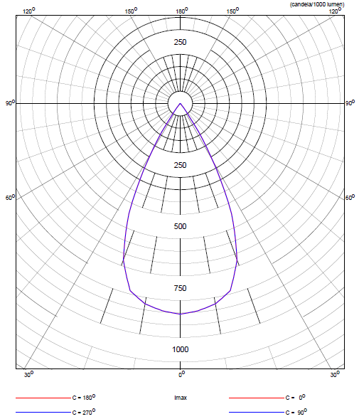
90W – CCT TUNABLE
PHOTOMETRIC PERFORMANCE
TM-30
SPECTRUM
SOFT PANEL LIGHT
POLAR DIAGRAM – FLOOD
Photometric Data - Flood @ 100 Degrees - 3200K
Throw Distance | (m) | 1 | 2 | 3 | 5 | 7
 | (ft)
Beam Diameter | (m)
 | (ft)
Illumination | (lux) | 99999 | 99999 | 99999 | 99999 | 99999
 | (fc)
Photometric Data - Flood @ 50 Degrees - 5600K
Throw Distance | (m) | 1 | 2 | 3 | 5 | 7
 | (ft)
Beam Diameter | (m)
 | (ft)
Illumination | (lux) | 99999 | 99999 | 99999 | 99999 | 99999
 | (fc)
POLAR DIAGRAM - FLOOD
3 of 3
Design, Manufacture and Tested at Canara Lighting Industries Pvt. Ltd. Mulky-Kinnigoli Airport Road Mangalore 574 150. India.
We innovate continuously to improve specifications, design, manufacturing techniques etc. hence technical data and offerings are subject to change without prior notice. Individual test results may vary. Results based on a representative sample in Canara inventory.

Slide 22
90W – CCT TUNABLE
PHOTOMETRIC
PERFORMANCE
TM-30
SPECTRUM
SOFT PANEL LIGHT
Photometric Data - Flood @ 100 Degrees - 4700K
Throw Distance | (m) | 1 | 2 | 3 | 5 | 7
 | (ft)
Beam Diameter | (m)
 | (ft)
Illumination | (lux) | 99999 | 99999 | 99999 | 99999 | 99999
 | (fc)
POLAR DIAGRAM – FLOOD
TM-30
SPECTRUM
3 of 3
Design, Manufacture and Tested at Canara Lighting Industries Pvt. Ltd. Mulky-Kinnigoli Airport Road Mangalore 574 150. India.
We innovate continuously to improve specifications, design, manufacturing techniques etc. hence technical data and offerings are subject to change without prior notice. Individual test results may vary. Results based on a representative sample in Canara inventory.

Slide 23
90W – 5600K
Canara LED Panel series LED lighting system has been specifically developed for film and video applications that demand extremely color-accurate, high quality light. Utilizing proprietary, state-of-the-art, daylight balanced LEDs, Canara LED Panel creates a high volume of broad spectrum white light, combined with an electronic flicker-free dimmable power supply unit to create a powerful yet economical LED soft light. Perfect for TV studio, Production Studios, Film Recordings & Documentaries etc.,
SOFT PANEL LIGHT
MODEL : CAN LED T
SPECIAL FEATURES
Delivers the High-volume light output.
Double accessories slot for inserting color Filters, Barndoor and other accessories with lock retaining clip.
Fully RDM Compliant when in DMX mode
Electronic universal power supply 100-260 V AC, 50/60 Hz.
Non-glare, diffuser provides uniform, single source light.
Efficient power and thermal management delivers low power consumption and enhanced reliability.
Fanless design perfect for studio application
All metal construction.
No light spill to distract audiences or performers.
Available with pole operated yoke.
TECHNICAL SPECIFICATIONS
LIGHT SOURCE
Lamp : SMD LED ARRAY
Color temperature (CCT) : 5600K
CRI : > 95, TLCI: > 95, R9 Value: > 95
Color Quality Scale (CQS) : > 95
Lamp life : L70 >50000 Hours @ 55°C
OPTICAL SYSTEM
Beam Angle : 100°
Acrylic milky diffuser 2 mm /3mm thick provides eye pleasant light output.
1 of 3
We innovate continuously to improve specifications, design, manufacturing techniques etc. hence technical data and offerings are subject to change without prior notice. Individual test results may vary. Results based on a representative sample in Canara inventory.

Slide 24
90W – 5600K
ELECTRICAL
Flicker free auto-ranging electronic switch mode power supply 100~240 VAC Nominal, 50/60 Hz
0 to 100% 8 Bit Linear Dimming
Power Factor ≥0.95 @ 230V 50Hz
Main fuse - T12A-250V
Max mains current 3.7A@drawn 1A @ 230V 50Hz
Max LED current drawn 54V DC
Power supply cable: 2 meter 3 Core 1Sq mm FRLS grade PVC cable with IEC Plug
ACCESSORIES
 | 8 leaf Barndoor
 | 4 leaf Barndoor
 | Softbox
 | Honey comb screens
 | Filter frame
 | Clamps & Spuds
 | Cables
SOFT PANEL LIGHT
CONTROL
On board Control with 5 No's High Precision Membrane switch with 7 segment display for easy to read status.
USITT DMX512A (RDM Compatible) Control Protocol.
5 pin locking XLR Chasis mount DMX in & through connections
8 bit DMX control, extra soft dimming, for theatrical & Studio use.
DMX CHART
1 Channel Mode : Dimmer, 0-100%
PHYSICAL
Aluminum laser cut body
Passive Cooling system with large heatsink, no noise, perfect for TV studios & theatres
Aluminium yoke
Available in Manual and Pole operated system for Pan, Tilt and Focus.
Epoxy polyester powder coated matt black finish (RAL – 9005) (Customizable as per requirements)
IP Rating : IP20
WEIGHT & DIMENTIONS
 | Normal Yoke | POS Yoke | Unit
Weight | 7.6 | 9.8 | Kg
Length | 370 |  | mm
Width | 250 |  | mm
Height | 295 |  | mm
2 of 3
We innovate continuously to improve specifications, design, manufacturing techniques etc. hence technical data and offerings are subject to change without prior notice. Individual test results may vary. Results based on a representative sample in Canara inventory.

Slide 25
90W – 5600K
PHOTOMETRIC PERFORMANCE
TM-30
SPECTRUM
SOFT PANEL LIGHT
POLAR DIAGRAM – FLOOD
Photometric Data - Flood @ 100 Degrees - 5600K
Throw Distance | (m) | 1 | 2 | 3 | 5 | 7
 | (ft)
Beam Diameter | (m)
 | (ft)
Illumination | (lux) | 99999 | 99999 | 99999 | 99999 | 99999
 | (fc)
3 of 3
Design, Manufacture and Tested at Canara Lighting Industries Pvt. Ltd. Mulky-Kinnigoli Airport Road Mangalore 574 150. India.
We innovate continuously to improve specifications, design, manufacturing techniques etc. hence technical data and offerings are subject to change without prior notice. Individual test results may vary. Results based on a representative sample in Canara inventory.

Slide 26
90W – 3200K
Canara LED Panel series LED lighting system has been specifically developed for film and video applications that demand extremely color-accurate, high quality light. Utilizing proprietary, state-of-the-art, daylight balanced LEDs, Canara LED Panel creates a high volume of broad spectrum white light, combined with an electronic flicker-free dimmable power supply unit to create a powerful yet economical LED soft light. Perfect for TV studio, Production Studios, Film Recordings & Documentaries etc.,
SOFT PANEL LIGHT
MODEL : CAN LED T
SPECIAL FEATURES
Delivers the High-volume light output.
Double accessories slot for inserting color Filters, Barndoor and other accessories with lock retaining clip.
Fully RDM Compliant when in DMX mode
Electronic universal power supply 100-260 V AC, 50/60 Hz.
Non-glare, diffuser provides uniform, single source light.
Efficient power and thermal management delivers low power consumption and enhanced reliability.
Fanless design perfect for studio application
All metal construction.
No light spill to distract audiences or performers.
Available with pole operated yoke.
TECHNICAL SPECIFICATIONS
LIGHT SOURCE
Lamp : SMD LED ARRAY
Color temperature (CCT) : 5600K
CRI : > 95, TLCI: > 95, R9 Value: > 95
Color Quality Scale (CQS) : > 95
Lamp life : L70 >50000 Hours @ 55°C
OPTICAL SYSTEM
Beam Angle : 100°
Acrylic milky diffuser 2 mm /3mm thick provides eye pleasant light output.
1 of 3
We innovate continuously to improve specifications, design, manufacturing techniques etc. hence technical data and offerings are subject to change without prior notice. Individual test results may vary. Results based on a representative sample in Canara inventory.

Slide 27
90W – 3200K
ELECTRICAL
Flicker free auto-ranging electronic switch mode power supply 100~240 VAC Nominal, 50/60 Hz
0 to 100% 8 Bit Linear Dimming
Power Factor ≥0.95 @ 230V 50Hz
Main fuse - T12A-250V
Max mains current 3.7A@drawn 1A @ 230V 50Hz
Max LED current drawn 54V DC
Power supply cable: 2 meter 3 Core 1Sq mm FRLS grade PVC cable with IEC Plug
ACCESSORIES
 | 8 leaf Barndoor
 | 4 leaf Barndoor
 | Softbox
 | Honey comb screens
 | Filter frame
 | Clamps & Spuds
 | Cables
SOFT PANEL LIGHT
CONTROL
On board Control with 5 No's High Precision Membrane switch with 7 segment display for easy to read status.
USITT DMX512A (RDM Compatible) Control Protocol.
5 pin locking XLR Chasis mount DMX in & through connections
8 bit DMX control, extra soft dimming, for theatrical & Studio use.
DMX CHART
1 Channel Mode : Dimmer, 0-100%
PHYSICAL
Aluminum laser cut body
Passive Cooling system with large heatsink, no noise, perfect for TV studios & theatres
Aluminium yoke
Available in Manual and Pole operated system for Pan, Tilt and Focus.
Epoxy polyester powder coated matt black finish (RAL – 9005) (Customizable as per requirements)
IP Rating : IP20
WEIGHT & DIMENTIONS
 | Normal Yoke | POS Yoke | Unit
Weight | 7.6 | 9.8 | Kg
Length | 370 |  | mm
Width | 250 |  | mm
Height | 295 |  | mm
2 of 3
We innovate continuously to improve specifications, design, manufacturing techniques etc. hence technical data and offerings are subject to change without prior notice. Individual test results may vary. Results based on a representative sample in Canara inventory.

Slide 28
90W – 3200K
PHOTOMETRIC PERFORMANCE
TM-30
SPECTRUM
SOFT PANEL LIGHT
POLAR DIAGRAM – FLOOD
Photometric Data - Flood @ 100 Degrees - 5600K
Throw Distance | (m) | 1 | 2 | 3 | 5 | 7
 | (ft)
Beam Diameter | (m)
 | (ft)
Illumination | (lux) | 99999 | 99999 | 99999 | 99999 | 99999
 | (fc)
3 of 3
Design, Manufacture and Tested at Canara Lighting Industries Pvt. Ltd. Mulky-Kinnigoli Airport Road Mangalore 574 150. India.
We innovate continuously to improve specifications, design, manufacturing techniques etc. hence technical data and offerings are subject to change without prior notice. Individual test results may vary. Results based on a representative sample in Canara inventory.

Slide 29
90W – CCT TUNABLE
Canara LED Panel series LED lighting system has been specifically developed for film and video applications that demand extremely color-accurate, high quality light. Utilizing proprietary, state-of-the-art, daylight balanced LEDs, Canara LED Panel creates a high volume of broad spectrum white light, combined with an electronic flicker-free dimmable power supply unit to create a powerful yet economical LED soft light. Perfect for TV studio, Production Studios, Film Recordings & Documentaries etc.,
SOFT PANEL LIGHT
MODEL : CAN LED T
SPECIAL FEATURES
Delivers the High-volume light output.
Double accessories slot for inserting color Filters, Barndoor and other accessories with lock retaining clip.
Fully RDM Compliant when in DMX mode
Electronic universal power supply 100-260 V AC, 50/60 Hz.
Non-glare, diffuser provides uniform, single source light.
Efficient power and thermal management delivers low power consumption and enhanced reliability.
Fanless design perfect for studio application
All metal construction.
No light spill to distract audiences or performers.
Available with pole operated yoke.
TECHNICAL SPECIFICATIONS
LIGHT SOURCE
Lamp : SMD LED ARRAY
Color temperature (CCT) : 5600K
CRI : > 95, TLCI: > 95, R9 Value: > 95
Color Quality Scale (CQS) : > 95
Lamp life : L70 >50000 Hours @ 55°C
OPTICAL SYSTEM
Beam Angle : 100°
Acrylic milky diffuser 2 mm /3mm thick provides eye pleasant light output.
1 of 3
We innovate continuously to improve specifications, design, manufacturing techniques etc. hence technical data and offerings are subject to change without prior notice. Individual test results may vary. Results based on a representative sample in Canara inventory.

Slide 30
90W – CCT TUNABLE
ELECTRICAL
Flicker free auto-ranging electronic switch mode power supply 100~240 VAC Nominal, 50/60 Hz
0 to 100% 8 Bit Linear Dimming
Power Factor ≥0.95 @ 230V 50Hz
Main fuse - T12A-250V
Max mains current 3.7A@drawn 1A @ 230V 50Hz
Max LED current drawn 54V DC
Power supply cable: 2 meter 3 Core 1Sq mm FRLS grade PVC cable with IEC Plug
ACCESSORIES
 | 8 leaf Barndoor
 | 4 leaf Barndoor
 | Softbox
 | Honey comb screens
 | Filter frame
 | Clamps & Spuds
 | Cables
SOFT PANEL LIGHT
CONTROL
On board Control with 5 No's High Precision Membrane switch with 7 segment display for easy to read status.
USITT DMX512A (RDM Compatible) Control Protocol.
5 pin locking XLR Chasis mount DMX in & through connections
8 bit DMX control, extra soft dimming, for theatrical & Studio use.
DMX CHART
1 Channel Mode : Dimmer, 0-100%
PHYSICAL
Aluminum laser cut body
Passive Cooling system with large heatsink, no noise, perfect for TV studios & theatres
Aluminium yoke
Available in Manual and Pole operated system for Pan, Tilt and Focus.
Epoxy polyester powder coated matt black finish (RAL – 9005) (Customizable as per requirements)
IP Rating : IP20
WEIGHT & DIMENTIONS
 | Normal Yoke | POS Yoke | Unit
Weight | 7.6 | 9.8 | Kg
Length | 370 |  | mm
Width | 250 |  | mm
Height | 295 |  | mm
2 of 3
We innovate continuously to improve specifications, design, manufacturing techniques etc. hence technical data and offerings are subject to change without prior notice. Individual test results may vary. Results based on a representative sample in Canara inventory.

Slide 31
90W – CCT TUNABLE
PHOTOMETRIC PERFORMANCE
TM-30
SPECTRUM
SOFT PANEL LIGHT
POLAR DIAGRAM – FLOOD
Photometric Data - Flood @ 100 Degrees - 3200K
Throw Distance | (m) | 1 | 2 | 3 | 5 | 7
 | (ft)
Beam Diameter | (m)
 | (ft)
Illumination | (lux) | 99999 | 99999 | 99999 | 99999 | 99999
 | (fc)
Photometric Data - Flood @ 50 Degrees - 5600K
Throw Distance | (m) | 1 | 2 | 3 | 5 | 7
 | (ft)
Beam Diameter | (m)
 | (ft)
Illumination | (lux) | 99999 | 99999 | 99999 | 99999 | 99999
 | (fc)
POLAR DIAGRAM - FLOOD
3 of 3
Design, Manufacture and Tested at Canara Lighting Industries Pvt. Ltd. Mulky-Kinnigoli Airport Road Mangalore 574 150. India.
We innovate continuously to improve specifications, design, manufacturing techniques etc. hence technical data and offerings are subject to change without prior notice. Individual test results may vary. Results based on a representative sample in Canara inventory.

Slide 32
90W – CCT TUNABLE
PHOTOMETRIC
PERFORMANCE
TM-30
SPECTRUM
SOFT PANEL LIGHT
Photometric Data - Flood @ 100 Degrees - 4700K
Throw Distance | (m) | 1 | 2 | 3 | 5 | 7
 | (ft)
Beam Diameter | (m)
 | (ft)
Illumination | (lux) | 99999 | 99999 | 99999 | 99999 | 99999
 | (fc)
POLAR DIAGRAM – FLOOD
TM-30
SPECTRUM
3 of 3
Design, Manufacture and Tested at Canara Lighting Industries Pvt. Ltd. Mulky-Kinnigoli Airport Road Mangalore 574 150. India.
We innovate continuously to improve specifications, design, manufacturing techniques etc. hence technical data and offerings are subject to change without prior notice. Individual test results may vary. Results based on a representative sample in Canara inventory.

Slide 33
90W – 5600K
Canara LED Panel series LED lighting system has been specifically developed for film and video applications that demand extremely color-accurate, high quality light. Utilizing proprietary, state-of-the-art, daylight balanced LEDs, Canara LED Panel creates a high volume of broad spectrum white light, combined with an electronic flicker-free dimmable power supply unit to create a powerful yet economical LED soft light. Perfect for TV studio, Production Studios, Film Recordings & Documentaries etc.,
SOFT PANEL LIGHT
MODEL : CAN LED T
SPECIAL FEATURES
Delivers the High-volume light output.
Double accessories slot for inserting color Filters, Barndoor and other accessories with lock retaining clip.
Fully RDM Compliant when in DMX mode
Electronic universal power supply 100-260 V AC, 50/60 Hz.
Non-glare, diffuser provides uniform, single source light.
Efficient power and thermal management delivers low power consumption and enhanced reliability.
Fanless design perfect for studio application
All metal construction.
No light spill to distract audiences or performers.
Available with pole operated yoke.
TECHNICAL SPECIFICATIONS
LIGHT SOURCE
Lamp : SMD LED ARRAY
Color temperature (CCT) : 5600K
CRI : > 95, TLCI: > 95, R9 Value: > 95
Color Quality Scale (CQS) : > 95
Lamp life : L70 >50000 Hours @ 55°C
OPTICAL SYSTEM
Beam Angle : 100°
Acrylic milky diffuser 2 mm /3mm thick provides eye pleasant light output.
1 of 3
We innovate continuously to improve specifications, design, manufacturing techniques etc. hence technical data and offerings are subject to change without prior notice. Individual test results may vary. Results based on a representative sample in Canara inventory.

Slide 34
90W – 5600K
ELECTRICAL
Flicker free auto-ranging electronic switch mode power supply 100~240 VAC Nominal, 50/60 Hz
0 to 100% 8 Bit Linear Dimming
Power Factor ≥0.95 @ 230V 50Hz
Main fuse - T12A-250V
Max mains current 3.7A@drawn 1A @ 230V 50Hz
Max LED current drawn 54V DC
Power supply cable: 2 meter 3 Core 1Sq mm FRLS grade PVC cable with IEC Plug
ACCESSORIES
 | 8 leaf Barndoor
 | 4 leaf Barndoor
 | Softbox
 | Honey comb screens
 | Filter frame
 | Clamps & Spuds
 | Cables
SOFT PANEL LIGHT
CONTROL
On board Control with 5 No's High Precision Membrane switch with 7 segment display for easy to read status.
USITT DMX512A (RDM Compatible) Control Protocol.
5 pin locking XLR Chasis mount DMX in & through connections
8 bit DMX control, extra soft dimming, for theatrical & Studio use.
DMX CHART
1 Channel Mode : Dimmer, 0-100%
PHYSICAL
Aluminum laser cut body
Passive Cooling system with large heatsink, no noise, perfect for TV studios & theatres
Aluminium yoke
Available in Manual and Pole operated system for Pan, Tilt and Focus.
Epoxy polyester powder coated matt black finish (RAL – 9005) (Customizable as per requirements)
IP Rating : IP20
WEIGHT & DIMENTIONS
 | Normal Yoke | POS Yoke | Unit
Weight | 7.6 | 9.8 | Kg
Length | 370 |  | mm
Width | 250 |  | mm
Height | 295 |  | mm
2 of 3
We innovate continuously to improve specifications, design, manufacturing techniques etc. hence technical data and offerings are subject to change without prior notice. Individual test results may vary. Results based on a representative sample in Canara inventory.

Slide 35
90W – 5600K
PHOTOMETRIC PERFORMANCE
TM-30
SPECTRUM
SOFT PANEL LIGHT
POLAR DIAGRAM – FLOOD
Photometric Data - Flood @ 100 Degrees - 5600K
Throw Distance | (m) | 1 | 2 | 3 | 5 | 7
 | (ft)
Beam Diameter | (m)
 | (ft)
Illumination | (lux) | 99999 | 99999 | 99999 | 99999 | 99999
 | (fc)
3 of 3
Design, Manufacture and Tested at Canara Lighting Industries Pvt. Ltd. Mulky-Kinnigoli Airport Road Mangalore 574 150. India.
We innovate continuously to improve specifications, design, manufacturing techniques etc. hence technical data and offerings are subject to change without prior notice. Individual test results may vary. Results based on a representative sample in Canara inventory.

Slide 36
90W – 3200K
Canara LED Panel series LED lighting system has been specifically developed for film and video applications that demand extremely color-accurate, high quality light. Utilizing proprietary, state-of-the-art, daylight balanced LEDs, Canara LED Panel creates a high volume of broad spectrum white light, combined with an electronic flicker-free dimmable power supply unit to create a powerful yet economical LED soft light. Perfect for TV studio, Production Studios, Film Recordings & Documentaries etc.,
SOFT PANEL LIGHT
MODEL : CAN LED T
SPECIAL FEATURES
Delivers the High-volume light output.
Double accessories slot for inserting color Filters, Barndoor and other accessories with lock retaining clip.
Fully RDM Compliant when in DMX mode
Electronic universal power supply 100-260 V AC, 50/60 Hz.
Non-glare, diffuser provides uniform, single source light.
Efficient power and thermal management delivers low power consumption and enhanced reliability.
Fanless design perfect for studio application
All metal construction.
No light spill to distract audiences or performers.
Available with pole operated yoke.
TECHNICAL SPECIFICATIONS
LIGHT SOURCE
Lamp : SMD LED ARRAY
Color temperature (CCT) : 5600K
CRI : > 95, TLCI: > 95, R9 Value: > 95
Color Quality Scale (CQS) : > 95
Lamp life : L70 >50000 Hours @ 55°C
OPTICAL SYSTEM
Beam Angle : 100°
Acrylic milky diffuser 2 mm /3mm thick provides eye pleasant light output.
1 of 3
We innovate continuously to improve specifications, design, manufacturing techniques etc. hence technical data and offerings are subject to change without prior notice. Individual test results may vary. Results based on a representative sample in Canara inventory.

Slide 37
90W – 3200K
ELECTRICAL
Flicker free auto-ranging electronic switch mode power supply 100~240 VAC Nominal, 50/60 Hz
0 to 100% 8 Bit Linear Dimming
Power Factor ≥0.95 @ 230V 50Hz
Main fuse - T12A-250V
Max mains current 3.7A@drawn 1A @ 230V 50Hz
Max LED current drawn 54V DC
Power supply cable: 2 meter 3 Core 1Sq mm FRLS grade PVC cable with IEC Plug
ACCESSORIES
 | 8 leaf Barndoor
 | 4 leaf Barndoor
 | Softbox
 | Honey comb screens
 | Filter frame
 | Clamps & Spuds
 | Cables
SOFT PANEL LIGHT
CONTROL
On board Control with 5 No's High Precision Membrane switch with 7 segment display for easy to read status.
USITT DMX512A (RDM Compatible) Control Protocol.
5 pin locking XLR Chasis mount DMX in & through connections
8 bit DMX control, extra soft dimming, for theatrical & Studio use.
DMX CHART
1 Channel Mode : Dimmer, 0-100%
PHYSICAL
Aluminum laser cut body
Passive Cooling system with large heatsink, no noise, perfect for TV studios & theatres
Aluminium yoke
Available in Manual and Pole operated system for Pan, Tilt and Focus.
Epoxy polyester powder coated matt black finish (RAL – 9005) (Customizable as per requirements)
IP Rating : IP20
WEIGHT & DIMENTIONS
 | Normal Yoke | POS Yoke | Unit
Weight | 7.6 | 9.8 | Kg
Length | 370 |  | mm
Width | 250 |  | mm
Height | 295 |  | mm
2 of 3
We innovate continuously to improve specifications, design, manufacturing techniques etc. hence technical data and offerings are subject to change without prior notice. Individual test results may vary. Results based on a representative sample in Canara inventory.

Slide 38
90W – 3200K
PHOTOMETRIC PERFORMANCE
TM-30
SPECTRUM
SOFT PANEL LIGHT
POLAR DIAGRAM – FLOOD
Photometric Data - Flood @ 100 Degrees - 5600K
Throw Distance | (m) | 1 | 2 | 3 | 5 | 7
 | (ft)
Beam Diameter | (m)
 | (ft)
Illumination | (lux) | 99999 | 99999 | 99999 | 99999 | 99999
 | (fc)
3 of 3
Design, Manufacture and Tested at Canara Lighting Industries Pvt. Ltd. Mulky-Kinnigoli Airport Road Mangalore 574 150. India.
We innovate continuously to improve specifications, design, manufacturing techniques etc. hence technical data and offerings are subject to change without prior notice. Individual test results may vary. Results based on a representative sample in Canara inventory.

Slide 39
90W – CCT TUNABLE
Canara LED Panel series LED lighting system has been specifically developed for film and video applications that demand extremely color-accurate, high quality light. Utilizing proprietary, state-of-the-art, daylight balanced LEDs, Canara LED Panel creates a high volume of broad spectrum white light, combined with an electronic flicker-free dimmable power supply unit to create a powerful yet economical LED soft light. Perfect for TV studio, Production Studios, Film Recordings & Documentaries etc.,
SOFT PANEL LIGHT
MODEL : CAN LED T
SPECIAL FEATURES
Delivers the High-volume light output.
Double accessories slot for inserting color Filters, Barndoor and other accessories with lock retaining clip.
Fully RDM Compliant when in DMX mode
Electronic universal power supply 100-260 V AC, 50/60 Hz.
Non-glare, diffuser provides uniform, single source light.
Efficient power and thermal management delivers low power consumption and enhanced reliability.
Fanless design perfect for studio application
All metal construction.
No light spill to distract audiences or performers.
Available with pole operated yoke.
TECHNICAL SPECIFICATIONS
LIGHT SOURCE
Lamp : SMD LED ARRAY
Color temperature (CCT) : 5600K
CRI : > 95, TLCI: > 95, R9 Value: > 95
Color Quality Scale (CQS) : > 95
Lamp life : L70 >50000 Hours @ 55°C
OPTICAL SYSTEM
Beam Angle : 100°
Acrylic milky diffuser 2 mm /3mm thick provides eye pleasant light output.
1 of 3
We innovate continuously to improve specifications, design, manufacturing techniques etc. hence technical data and offerings are subject to change without prior notice. Individual test results may vary. Results based on a representative sample in Canara inventory.

Slide 40
90W – CCT TUNABLE
ELECTRICAL
Flicker free auto-ranging electronic switch mode power supply 100~240 VAC Nominal, 50/60 Hz
0 to 100% 8 Bit Linear Dimming
Power Factor ≥0.95 @ 230V 50Hz
Main fuse - T12A-250V
Max mains current 3.7A@drawn 1A @ 230V 50Hz
Max LED current drawn 54V DC
Power supply cable: 2 meter 3 Core 1Sq mm FRLS grade PVC cable with IEC Plug
ACCESSORIES
 | 8 leaf Barndoor
 | 4 leaf Barndoor
 | Softbox
 | Honey comb screens
 | Filter frame
 | Clamps & Spuds
 | Cables
SOFT PANEL LIGHT
CONTROL
On board Control with 5 No's High Precision Membrane switch with 7 segment display for easy to read status.
USITT DMX512A (RDM Compatible) Control Protocol.
5 pin locking XLR Chasis mount DMX in & through connections
8 bit DMX control, extra soft dimming, for theatrical & Studio use.
DMX CHART
1 Channel Mode : Dimmer, 0-100%
PHYSICAL
Aluminum laser cut body
Passive Cooling system with large heatsink, no noise, perfect for TV studios & theatres
Aluminium yoke
Available in Manual and Pole operated system for Pan, Tilt and Focus.
Epoxy polyester powder coated matt black finish (RAL – 9005) (Customizable as per requirements)
IP Rating : IP20
WEIGHT & DIMENTIONS
 | Normal Yoke | POS Yoke | Unit
Weight | 7.6 | 9.8 | Kg
Length | 370 |  | mm
Width | 250 |  | mm
Height | 295 |  | mm
2 of 3
We innovate continuously to improve specifications, design, manufacturing techniques etc. hence technical data and offerings are subject to change without prior notice. Individual test results may vary. Results based on a representative sample in Canara inventory.

Slide 41
90W – CCT TUNABLE
PHOTOMETRIC PERFORMANCE
TM-30
SPECTRUM
SOFT PANEL LIGHT
POLAR DIAGRAM – FLOOD
Photometric Data - Flood @ 100 Degrees - 3200K
Throw Distance | (m) | 1 | 2 | 3 | 5 | 7
 | (ft)
Beam Diameter | (m)
 | (ft)
Illumination | (lux) | 99999 | 99999 | 99999 | 99999 | 99999
 | (fc)
Photometric Data - Flood @ 50 Degrees - 5600K
Throw Distance | (m) | 1 | 2 | 3 | 5 | 7
 | (ft)
Beam Diameter | (m)
 | (ft)
Illumination | (lux) | 99999 | 99999 | 99999 | 99999 | 99999
 | (fc)
POLAR DIAGRAM - FLOOD
3 of 3
Design, Manufacture and Tested at Canara Lighting Industries Pvt. Ltd. Mulky-Kinnigoli Airport Road Mangalore 574 150. India.
We innovate continuously to improve specifications, design, manufacturing techniques etc. hence technical data and offerings are subject to change without prior notice. Individual test results may vary. Results based on a representative sample in Canara inventory.

Slide 42
90W – CCT TUNABLE
PHOTOMETRIC
PERFORMANCE
TM-30
SPECTRUM
SOFT PANEL LIGHT
Photometric Data - Flood @ 100 Degrees - 4700K
Throw Distance | (m) | 1 | 2 | 3 | 5 | 7
 | (ft)
Beam Diameter | (m)
 | (ft)
Illumination | (lux) | 99999 | 99999 | 99999 | 99999 | 99999
 | (fc)
POLAR DIAGRAM – FLOOD
TM-30
SPECTRUM
3 of 3
Design, Manufacture and Tested at Canara Lighting Industries Pvt. Ltd. Mulky-Kinnigoli Airport Road Mangalore 574 150. India.
We innovate continuously to improve specifications, design, manufacturing techniques etc. hence technical data and offerings are subject to change without prior notice. Individual test results may vary. Results based on a representative sample in Canara inventory.

Slide 43
90W – 5600K
Canara LED Panel series LED lighting system has been specifically developed for film and video applications that demand extremely color-accurate, high quality light. Utilizing proprietary, state-of-the-art, daylight balanced LEDs, Canara LED Panel creates a high volume of broad spectrum white light, combined with an electronic flicker-free dimmable power supply unit to create a powerful yet economical LED soft light. Perfect for TV studio, Production Studios, Film Recordings & Documentaries etc.,
SOFT PANEL LIGHT
MODEL : CAN LED T
SPECIAL FEATURES
Delivers the High-volume light output.
Double accessories slot for inserting color Filters, Barndoor and other accessories with lock retaining clip.
Fully RDM Compliant when in DMX mode
Electronic universal power supply 100-260 V AC, 50/60 Hz.
Non-glare, diffuser provides uniform, single source light.
Efficient power and thermal management delivers low power consumption and enhanced reliability.
Fanless design perfect for studio application
All metal construction.
No light spill to distract audiences or performers.
Available with pole operated yoke.
TECHNICAL SPECIFICATIONS
LIGHT SOURCE
Lamp : SMD LED ARRAY
Color temperature (CCT) : 5600K
CRI : > 95, TLCI: > 95, R9 Value: > 95
Color Quality Scale (CQS) : > 95
Lamp life : L70 >50000 Hours @ 55°C
OPTICAL SYSTEM
Beam Angle : 100°
Acrylic milky diffuser 2 mm /3mm thick provides eye pleasant light output.
1 of 3
We innovate continuously to improve specifications, design, manufacturing techniques etc. hence technical data and offerings are subject to change without prior notice. Individual test results may vary. Results based on a representative sample in Canara inventory.

Slide 44
90W – 5600K
ELECTRICAL
Flicker free auto-ranging electronic switch mode power supply 100~240 VAC Nominal, 50/60 Hz
0 to 100% 8 Bit Linear Dimming
Power Factor ≥0.95 @ 230V 50Hz
Main fuse - T12A-250V
Max mains current 3.7A@drawn 1A @ 230V 50Hz
Max LED current drawn 54V DC
Power supply cable: 2 meter 3 Core 1Sq mm FRLS grade PVC cable with IEC Plug
ACCESSORIES
 | 8 leaf Barndoor
 | 4 leaf Barndoor
 | Softbox
 | Honey comb screens
 | Filter frame
 | Clamps & Spuds
 | Cables
SOFT PANEL LIGHT
CONTROL
On board Control with 5 No's High Precision Membrane switch with 7 segment display for easy to read status.
USITT DMX512A (RDM Compatible) Control Protocol.
5 pin locking XLR Chasis mount DMX in & through connections
8 bit DMX control, extra soft dimming, for theatrical & Studio use.
DMX CHART
1 Channel Mode : Dimmer, 0-100%
PHYSICAL
Aluminum laser cut body
Passive Cooling system with large heatsink, no noise, perfect for TV studios & theatres
Aluminium yoke
Available in Manual and Pole operated system for Pan, Tilt and Focus.
Epoxy polyester powder coated matt black finish (RAL – 9005) (Customizable as per requirements)
IP Rating : IP20
WEIGHT & DIMENTIONS
 | Normal Yoke | POS Yoke | Unit
Weight | 7.6 | 9.8 | Kg
Length | 370 |  | mm
Width | 250 |  | mm
Height | 295 |  | mm
2 of 3
We innovate continuously to improve specifications, design, manufacturing techniques etc. hence technical data and offerings are subject to change without prior notice. Individual test results may vary. Results based on a representative sample in Canara inventory.

Slide 45
90W – 5600K
PHOTOMETRIC PERFORMANCE
TM-30
SPECTRUM
SOFT PANEL LIGHT
POLAR DIAGRAM – FLOOD
Photometric Data - Flood @ 100 Degrees - 5600K
Throw Distance | (m) | 1 | 2 | 3 | 5 | 7
 | (ft)
Beam Diameter | (m)
 | (ft)
Illumination | (lux) | 99999 | 99999 | 99999 | 99999 | 99999
 | (fc)
3 of 3
Design, Manufacture and Tested at Canara Lighting Industries Pvt. Ltd. Mulky-Kinnigoli Airport Road Mangalore 574 150. India.
We innovate continuously to improve specifications, design, manufacturing techniques etc. hence technical data and offerings are subject to change without prior notice. Individual test results may vary. Results based on a representative sample in Canara inventory.

Slide 46
90W – 3200K
Canara LED Panel series LED lighting system has been specifically developed for film and video applications that demand extremely color-accurate, high quality light. Utilizing proprietary, state-of-the-art, daylight balanced LEDs, Canara LED Panel creates a high volume of broad spectrum white light, combined with an electronic flicker-free dimmable power supply unit to create a powerful yet economical LED soft light. Perfect for TV studio, Production Studios, Film Recordings & Documentaries etc.,
SOFT PANEL LIGHT
MODEL : CAN LED T
SPECIAL FEATURES
Delivers the High-volume light output.
Double accessories slot for inserting color Filters, Barndoor and other accessories with lock retaining clip.
Fully RDM Compliant when in DMX mode
Electronic universal power supply 100-260 V AC, 50/60 Hz.
Non-glare, diffuser provides uniform, single source light.
Efficient power and thermal management delivers low power consumption and enhanced reliability.
Fanless design perfect for studio application
All metal construction.
No light spill to distract audiences or performers.
Available with pole operated yoke.
TECHNICAL SPECIFICATIONS
LIGHT SOURCE
Lamp : SMD LED ARRAY
Color temperature (CCT) : 5600K
CRI : > 95, TLCI: > 95, R9 Value: > 95
Color Quality Scale (CQS) : > 95
Lamp life : L70 >50000 Hours @ 55°C
OPTICAL SYSTEM
Beam Angle : 100°
Acrylic milky diffuser 2 mm /3mm thick provides eye pleasant light output.
1 of 3
We innovate continuously to improve specifications, design, manufacturing techniques etc. hence technical data and offerings are subject to change without prior notice. Individual test results may vary. Results based on a representative sample in Canara inventory.

Slide 47
90W – 3200K
ELECTRICAL
Flicker free auto-ranging electronic switch mode power supply 100~240 VAC Nominal, 50/60 Hz
0 to 100% 8 Bit Linear Dimming
Power Factor ≥0.95 @ 230V 50Hz
Main fuse - T12A-250V
Max mains current 3.7A@drawn 1A @ 230V 50Hz
Max LED current drawn 54V DC
Power supply cable: 2 meter 3 Core 1Sq mm FRLS grade PVC cable with IEC Plug
ACCESSORIES
 | 8 leaf Barndoor
 | 4 leaf Barndoor
 | Softbox
 | Honey comb screens
 | Filter frame
 | Clamps & Spuds
 | Cables
SOFT PANEL LIGHT
CONTROL
On board Control with 5 No's High Precision Membrane switch with 7 segment display for easy to read status.
USITT DMX512A (RDM Compatible) Control Protocol.
5 pin locking XLR Chasis mount DMX in & through connections
8 bit DMX control, extra soft dimming, for theatrical & Studio use.
DMX CHART
1 Channel Mode : Dimmer, 0-100%
PHYSICAL
Aluminum laser cut body
Passive Cooling system with large heatsink, no noise, perfect for TV studios & theatres
Aluminium yoke
Available in Manual and Pole operated system for Pan, Tilt and Focus.
Epoxy polyester powder coated matt black finish (RAL – 9005) (Customizable as per requirements)
IP Rating : IP20
WEIGHT & DIMENTIONS
 | Normal Yoke | POS Yoke | Unit
Weight | 7.6 | 9.8 | Kg
Length | 370 |  | mm
Width | 250 |  | mm
Height | 295 |  | mm
2 of 3
We innovate continuously to improve specifications, design, manufacturing techniques etc. hence technical data and offerings are subject to change without prior notice. Individual test results may vary. Results based on a representative sample in Canara inventory.

Slide 48
90W – 3200K
PHOTOMETRIC PERFORMANCE
TM-30
SPECTRUM
SOFT PANEL LIGHT
POLAR DIAGRAM – FLOOD
Photometric Data - Flood @ 100 Degrees - 5600K
Throw Distance | (m) | 1 | 2 | 3 | 5 | 7
 | (ft)
Beam Diameter | (m)
 | (ft)
Illumination | (lux) | 99999 | 99999 | 99999 | 99999 | 99999
 | (fc)
3 of 3
Design, Manufacture and Tested at Canara Lighting Industries Pvt. Ltd. Mulky-Kinnigoli Airport Road Mangalore 574 150. India.
We innovate continuously to improve specifications, design, manufacturing techniques etc. hence technical data and offerings are subject to change without prior notice. Individual test results may vary. Results based on a representative sample in Canara inventory.

Slide 49
90W – CCT TUNABLE
Canara LED Panel series LED lighting system has been specifically developed for film and video applications that demand extremely color-accurate, high quality light. Utilizing proprietary, state-of-the-art, daylight balanced LEDs, Canara LED Panel creates a high volume of broad spectrum white light, combined with an electronic flicker-free dimmable power supply unit to create a powerful yet economical LED soft light. Perfect for TV studio, Production Studios, Film Recordings & Documentaries etc.,
SOFT PANEL LIGHT
MODEL : CAN LED T
SPECIAL FEATURES
Delivers the High-volume light output.
Double accessories slot for inserting color Filters, Barndoor and other accessories with lock retaining clip.
Fully RDM Compliant when in DMX mode
Electronic universal power supply 100-260 V AC, 50/60 Hz.
Non-glare, diffuser provides uniform, single source light.
Efficient power and thermal management delivers low power consumption and enhanced reliability.
Fanless design perfect for studio application
All metal construction.
No light spill to distract audiences or performers.
Available with pole operated yoke.
TECHNICAL SPECIFICATIONS
LIGHT SOURCE
Lamp : SMD LED ARRAY
Color temperature (CCT) : 5600K
CRI : > 95, TLCI: > 95, R9 Value: > 95
Color Quality Scale (CQS) : > 95
Lamp life : L70 >50000 Hours @ 55°C
OPTICAL SYSTEM
Beam Angle : 100°
Acrylic milky diffuser 2 mm /3mm thick provides eye pleasant light output.
1 of 3
We innovate continuously to improve specifications, design, manufacturing techniques etc. hence technical data and offerings are subject to change without prior notice. Individual test results may vary. Results based on a representative sample in Canara inventory.

Slide 50
90W – CCT TUNABLE
ELECTRICAL
Flicker free auto-ranging electronic switch mode power supply 100~240 VAC Nominal, 50/60 Hz
0 to 100% 8 Bit Linear Dimming
Power Factor ≥0.95 @ 230V 50Hz
Main fuse - T12A-250V
Max mains current 3.7A@drawn 1A @ 230V 50Hz
Max LED current drawn 54V DC
Power supply cable: 2 meter 3 Core 1Sq mm FRLS grade PVC cable with IEC Plug
ACCESSORIES
 | 8 leaf Barndoor
 | 4 leaf Barndoor
 | Softbox
 | Honey comb screens
 | Filter frame
 | Clamps & Spuds
 | Cables
SOFT PANEL LIGHT
CONTROL
On board Control with 5 No's High Precision Membrane switch with 7 segment display for easy to read status.
USITT DMX512A (RDM Compatible) Control Protocol.
5 pin locking XLR Chasis mount DMX in & through connections
8 bit DMX control, extra soft dimming, for theatrical & Studio use.
DMX CHART
1 Channel Mode : Dimmer, 0-100%
PHYSICAL
Aluminum laser cut body
Passive Cooling system with large heatsink, no noise, perfect for TV studios & theatres
Aluminium yoke
Available in Manual and Pole operated system for Pan, Tilt and Focus.
Epoxy polyester powder coated matt black finish (RAL – 9005) (Customizable as per requirements)
IP Rating : IP20
WEIGHT & DIMENTIONS
 | Normal Yoke | POS Yoke | Unit
Weight | 7.6 | 9.8 | Kg
Length | 370 |  | mm
Width | 250 |  | mm
Height | 295 |  | mm
2 of 3
We innovate continuously to improve specifications, design, manufacturing techniques etc. hence technical data and offerings are subject to change without prior notice. Individual test results may vary. Results based on a representative sample in Canara inventory.

Slide 51
90W – CCT TUNABLE
PHOTOMETRIC PERFORMANCE
TM-30
SPECTRUM
SOFT PANEL LIGHT
POLAR DIAGRAM – FLOOD
Photometric Data - Flood @ 100 Degrees - 3200K
Throw Distance | (m) | 1 | 2 | 3 | 5 | 7
 | (ft)
Beam Diameter | (m)
 | (ft)
Illumination | (lux) | 99999 | 99999 | 99999 | 99999 | 99999
 | (fc)
Photometric Data - Flood @ 50 Degrees - 5600K
Throw Distance | (m) | 1 | 2 | 3 | 5 | 7
 | (ft)
Beam Diameter | (m)
 | (ft)
Illumination | (lux) | 99999 | 99999 | 99999 | 99999 | 99999
 | (fc)
POLAR DIAGRAM - FLOOD
3 of 3
Design, Manufacture and Tested at Canara Lighting Industries Pvt. Ltd. Mulky-Kinnigoli Airport Road Mangalore 574 150. India.
We innovate continuously to improve specifications, design, manufacturing techniques etc. hence technical data and offerings are subject to change without prior notice. Individual test results may vary. Results based on a representative sample in Canara inventory.

Slide 52
90W – CCT TUNABLE
PHOTOMETRIC
PERFORMANCE
TM-30
SPECTRUM
SOFT PANEL LIGHT
Photometric Data - Flood @ 100 Degrees - 4700K
Throw Distance | (m) | 1 | 2 | 3 | 5 | 7
 | (ft)
Beam Diameter | (m)
 | (ft)
Illumination | (lux) | 99999 | 99999 | 99999 | 99999 | 99999
 | (fc)
POLAR DIAGRAM – FLOOD
TM-30
SPECTRUM
3 of 3
Design, Manufacture and Tested at Canara Lighting Industries Pvt. Ltd. Mulky-Kinnigoli Airport Road Mangalore 574 150. India.
We innovate continuously to improve specifications, design, manufacturing techniques etc. hence technical data and offerings are subject to change without prior notice. Individual test results may vary. Results based on a representative sample in Canara inventory.

Slide 53
LED LIGHTS
We innovate continuously, hence data & design given are subject to change without notice.
Individual test results may vary. Results based on a representative sample in Canara inventory.

Slide 56


Slide 57


