Slide 1


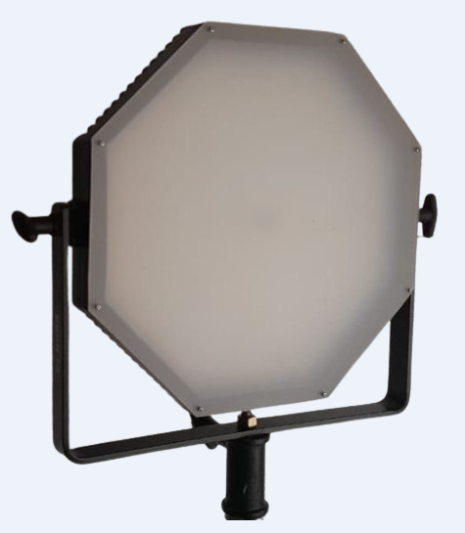
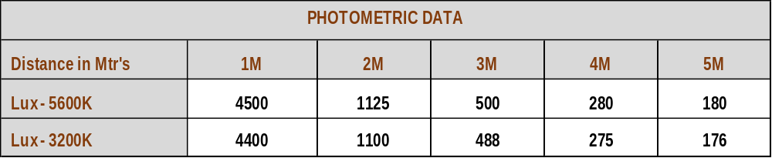

LED OCTAGONAL PANEL LIGHT
150W
High quality Canara LED Octagonal Panel light used as a Key light, Back light & Fill light with dimming option for creating many effects for multiple applications.
SPECIFICATIONS
Integrated dimmer enables instant
dimming from 0 to 100%.
- High grade Aluminum Housing with black
powder coated mat finish paint.
- Brightness is controlled through DMX
mode and Manual mode.
- Temperature of the lighting fixture is
controlled by Passive cooling heatsink
system. No noise.
- Comes with 2mtr power and DMX cable.
Lamp Power : 150W
Power Supply : 100 – 240V AC, 50-60Hz
FEATURES
CRI : > 95 , TLCI: >95
CCT : 5600K/3200K
Dimmer: 100-0% linearly adjustable
Control : DMX512 / RDM / Manual
Beam Angle : 100°
Finish : Aluminum housing with black heat resistance powder coat paint
Weight : 6.5Kg
Size : L410 x W410 x H110mm
Protection : IP20
Accessories (Optional) : Barndoor, Gel frame, Conical diffuser C- Clamp, DMX and Power cable.
Product Code : CLP-901D4S
* Photometric data measured from fixture yoke center
Applications :
Stage/Auditoriums, Studio & Film Lighting etc.,.
We innovate continuously, hence data & design given are subject to change without notice.

