Slide 1


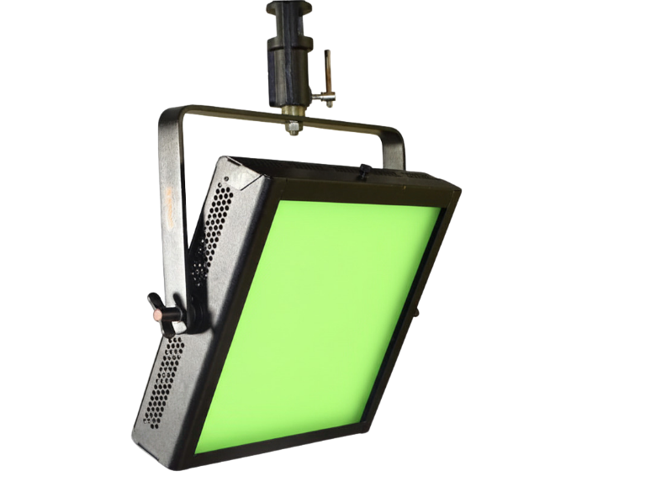
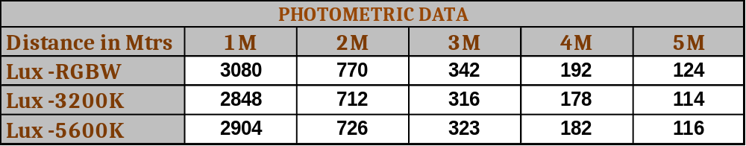

LED RGBW WASH LIGHT+CCT TUNABLE
150W
High quality Canara RGBW LED wash light used as wash, Chroma effect light, strobe light, studio light with dimming and colour option for creating many effects for multiple applications..
SPECIFICATIONS
150W RGBW LED wash panel gives soft
and perfect color homogeneity on light
output.
- Integrated dimmer enables instant
dimming from 0 to 100%.
High grade Aluminium Housing with black powder coated mat finish paint.
Passive cooling fixture (No noise)
Comes with 3mtr power and DMX cable.
Pole operated yoke system (optional).
CE certified light fixture.
Lamp Power : 150W
Power Supply : 100 – 240V AC, 50-60Hz
FEATURES
LED’s: RGBW
Color Temperature: Tunable 3000K to 7000K
CRI : >90
Control : DMX512 / RDM / Manual
DMX channels : 8 channel
Beam Angle : 100°
Dimming : 0 -100% dimmable
Features : CCT, Strobe, auto color change
Dimensions : W 360 x L 360 x H 125 mm
Weight : 5.6 Kg
Accessories (Optional) : C- Clamp,, Barndoor,
Product Code : CAN LED WASH 1215
* Photometric data measured from fixture yoke center
Applications :
TV studio, Production studios, Stage lighting etc.,.
We innovate continuously, hence data & design given are subject to change without notice.

