Slide 1


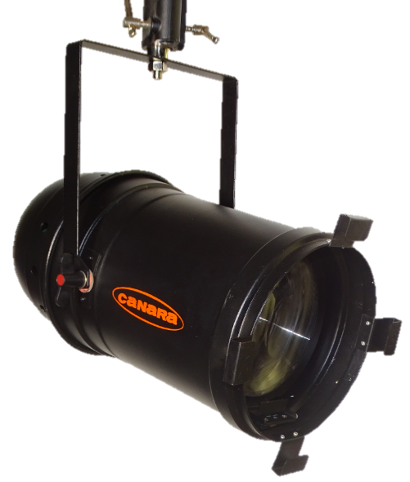
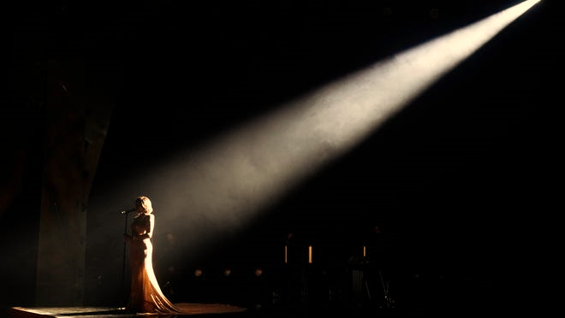
200W – PARCAN
Canara Parcan light equipped with an enhanced COB LED source providing a higher output with a significant efficiency, this is an LED retro-style Canara PARCAN perfect for a modern replacement of classic tungsten Parcan fixtures. This Parcan presents an exceptional flat and variable beam angle with Narrow to wide opening, combined with an electronic flicker-free dimmable power supply unit to create a powerful yet economical LED wash & Spotlight make it the perfect choice for theatre, auditoriums, TV studio, Production House, event and architectural applications.
SPECIAL FEATURES
Delivers the output performance of its 1000W Incandescent complement at 200W.
Single accessories slot for inserting color filters with lock retaining clip.
Fully RDM Compliant when in DMX mode
Wide range beam angle options
Minimum color temperature shift while dimming
Engineered plastic and metal construction.
No light spill to distract audiences or performers.
Available with pole operated yoke.
LED PARCAN LIGHT
MODEL : CAN LED PARCAN
TECHNICAL SPECIFICATIONS
LIGHT SOURCE
Lamp : 200W COB LED
Color temperature (CCT) : 3200K or 5600K
CRI : > 95, TLCI: > 95
Color Quality Scale (CQS) : > 95
Lamp life : L70 >50000 Hours @ 55°C
OPTICAL SYSTEM
Beam Angle : 9° / 15° / 20° / 25° / 30° selectable spot to flood beam spread.
Lens Material: Acrylic lens
Light characters : Parabolic beam of light
ELECTRICAL
Flicker free universal auto-ranging electronic switch mode power supply 100~240 VAC Nominal, 50/60 Hz
0 to 100% 8 Bit Linear Dimming
Power Factor ≥0.95 @ 230V 50Hz
Max mains current drawn 0.90A @ 230V AC 50Hz
Max LED current drawn 3.70A @ 54V DC
Power supply cable: 2 meter 3 Core 1Sq mm FRLS grade PVC cable with IEC Plug
DMX CHART
2 Channel Mode : 1. Dimmer, 2. Strobe
1 Channel Mode : 1. Dimmer
1 of 2
We innovate continuously to improve specifications, design, manufacturing techniques etc. hence technical data and offerings are subject to change without prior notice. Individual test results may vary. Results based on a representative sample in Canara inventory.

Slide 2


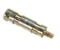
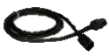
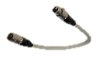
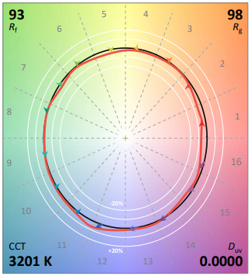
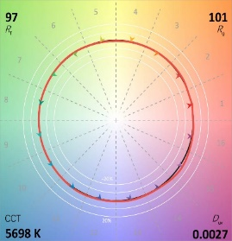
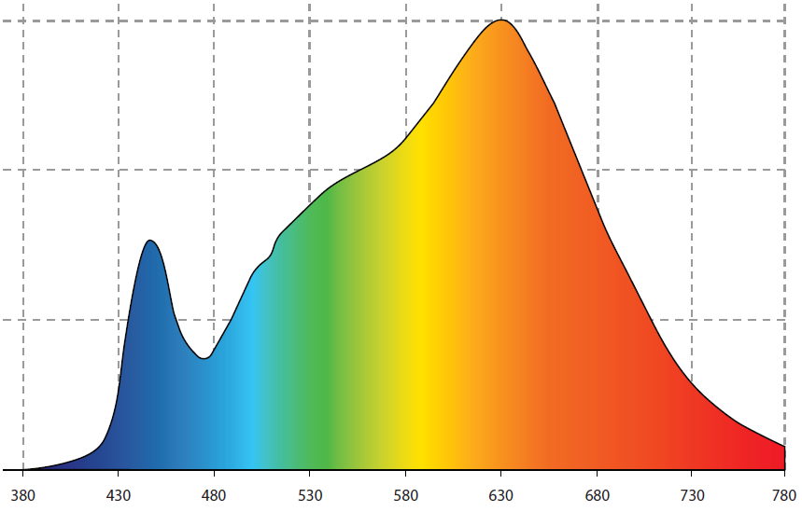
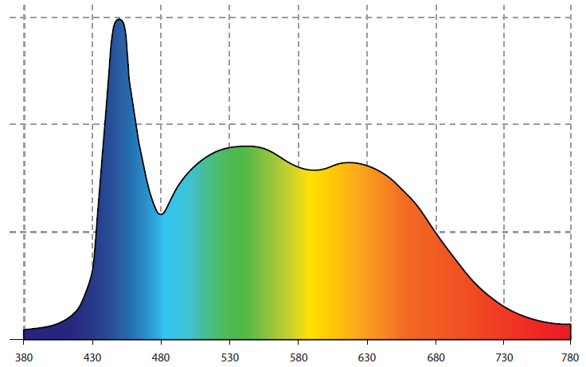
200W – PARCAN
CONTROL
On board Control with 4 No's High Precision Membrane switch with LCD display for easy to read status.
USITT DMX512A (RDM Compatible) Control Protocol.
5 pin locking XLR Chassis mount DMX in & through connections
8 bit DMX control, extra soft dimming, for theatrical & Studio use.
WEIGHT & DIMENTION
Length | Width | Height | Weight
440 mm | 245 mm | 350 mm | 3.5 Kg
1.44 ft | 0.80 ft | 1.15 ft | 7.72 lbs
ACCESSORIES(Optional)
LED PARCAN LIGHT
Gel Filter Frames
PHYSICAL
Rugged die-casted and extruded aluminium body
Active Cooling system by Aluminium heat sink with Silent-running cooling fans ideal for TV studios & theatres
Aluminum yoke
Available in Manual and Pole operated system for Pan, Tilt Movement.
Epoxy polyester powder coated matt black finish (RAL – 9005) (Customizable as per requirements)
IP Rating : IP20
Clamps & Spuds
Power & DMX Cables
TM-30(3200K)
TM-30(5600K)
SPECTRUM-3200K
SPECTRUM-5600K
Photometric Data
 |  | Spot mode @ 9 Degree |  |  |  | Flood mode @ 30 Degree
Throw Distance | (m) | 2 | 5 | 9 | 15 | 2 | 3 | 4 | 6
 | (ft) | 6.56 | 16.41 | 29.52 | 49.21 | 6.56 | 9.84 | 13.12 | 19.69
Beam Diameter | (m) | 0.31 | 0.79 | 1.42 | 2.36 | 1.07 | 1.61 | 2.14 | 3.22
 | (ft) | 1.03 | 2.58 | 4.65 | 7.75 | 3.52 | 5.28 | 7.04 | 10.55
Illumination 5600K | (lux) | 41900 | 6704 | 2069 | 745 | 4050 | 1800 | 1013 | 450
 | (fc) | 3893 | 623 | 192 | 69 | 376 | 167 | 94 | 42
Illumination 3200K | (lux) | 41200 | 6592 | 2035 | 732 | 3920 | 1742 | 980 | 436
 | (fc) | 3828 | 612 | 189 | 68 | 364 | 162 | 91 | 40
2 of 2
We innovate continuously to improve specifications, design, manufacturing techniques etc. hence technical data and offerings are subject to change without prior notice. Individual test results may vary. Results based on a representative sample in Canara inventory.

