Slide 1


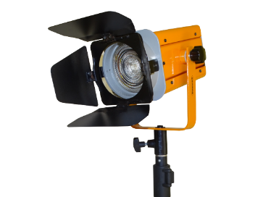
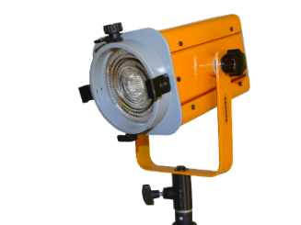
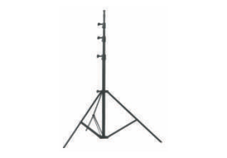

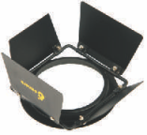
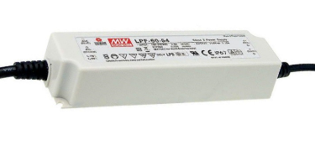
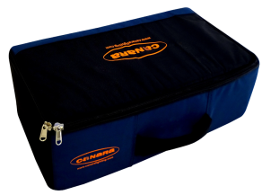

CCT TUNABLE LED ENG KIT
60W
High quality Canara LED CCT Tunable ENG KIT Light used as a Key Light, Back Light and Fill Light in indoor and outdoor studios.
SPECIFICATIONS
Light power : 60W
Canara 60W LED CCT Tunable ENG Light
delivers uniform field in the entire
focus area.
- Integrated dimmer enables instant dimming
from 0 to 100%.
- Aluminum die cast and sheet housing
with heat resistance paint.
- Temperature controlled by active cooling
system.
Brightness is controlled by DMX and manual mode.
Power Supply : 110 – 240V AC, 50-60Hz
FEATURES
CRI : >95., TLCI: >95
Dimming: 0-100%
Control: DMX / RDM / Manual control
Color temperature : 2700K~5700K
Beam angle : 36°
Light output : 1560 Lux @ 2mtr @ 5600K
1150 Lux @ 2mtr @ 3200K
Accessories: Barndoor, stand, carry case/bag
Product Code : CAN LED ENG 60CT
Canara ENG Kit includes
LED Light x 3nos
STD-1 stand x 3nos
4-leaf barndoor x 3nos
AC Adaptor x 3nos
Carry case – 2nos.
Applications :
TV Studios, Production Studios, Outdoor shootings,
Film Institutions, Film Recordings & Documentaries etc.,
We innovate continuously, hence data & design given are subject to change without notice.

