Slide 1


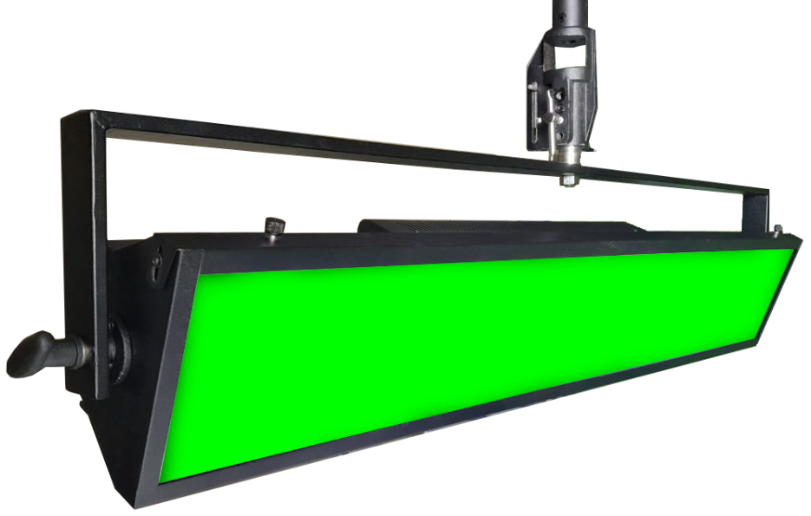
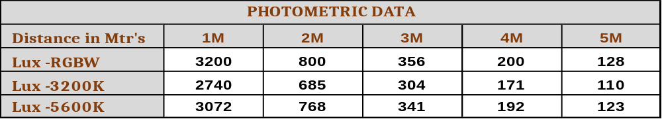

LED RGBW CHROMA WASH LIGHT+CCT TUNABLE
160W
High quality Canara RGBW LED Chroma wash light used as wash, Cyclorama effect light, strobe light, studio light with dimming and colour option for creating many effects for multiple applications..
SPECIFICATIONS
Lamp Power : 160W
Integrated dimmer enables instant
dimming from 0 to 100%.
- High grade Aluminum and MS Housing
with black powder coated mat finish
paint.
- Brightness is controlled through DMX
mode and Manual mode.
- Temperature of the lighting fixture is
controlled by Passive cooling heatsink
system. No noise.
Comes with 3mtr power and DMX cable.
CE certified light fixture.
Power Supply : 100 – 240V AC, 50-60Hz
FEATURES
LED’s: RGBW
Color Temperature: Tunable 3000K to 7000K
CRI : > 90
Control : DMX512 / RDM / Manual
DMX channels : 8 channel
Beam Angle : 100°
Dimming : 0 -100% dimmable
Features : CCT, Strobe, auto color change
Weight : 10.0 Kg
Size : L1180 x W215 x H150mm
Accessories (Optional) : 4 leaf Barndoor,
C- Clamp
Product Code : CAN LED WASH 1810
* Photometric data measured from fixture yoke center
Applications :
Stage/Auditoriums, Studio & Film Lighting etc.,.
We innovate continuously, hence data & design given are subject to change without notice.

