Slide 1


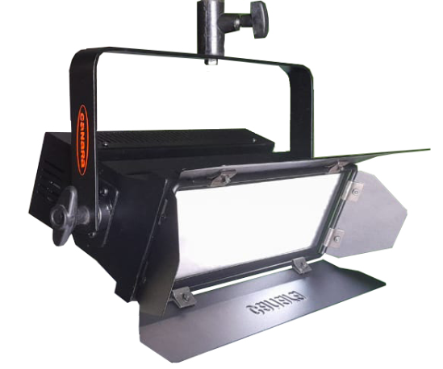
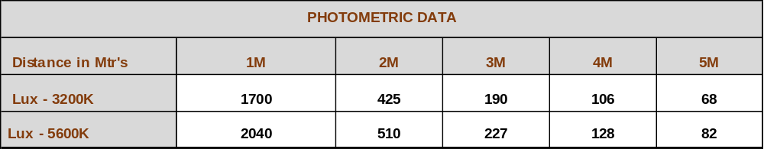

CCT TUNABLE LED PALM LIGHT
60W
High quality Canara LED CCT Tunable Palm Light used as a Key Light, Back Light and Fill Light in indoor and outdoor studios.
SPECIFICATIONS
Light power : 60W
Canara 60W LED CCT Tunable Palm Light delivers uniform field in the entire
focus area.
- Integrated dimmer enables instant dimming
from 0 to 100%.
- Aluminum extruded and MS sheet housing
with heat resistance black finish.
- Temperature controlled by passive cooling
system.
Brightness is controlled by DMX and manual mode.
Power Supply : 100 – 240V AC, 50-60Hz,
FEATURES
CRI : >95, TLCI: >95
Dimming: 0-100%
Control: DMX /RDM / Manual control
DMX channel: 2 channels
Color temperature : 3200K~5600K
Beam angle : 120°
Size: 360 x 150 x 160mm
Weight: 2.0Kg
Product Code : CAN LED ENG 60CT
* Photometric data measured from fixture yoke center
Applications :
TV Studios, Production Studios, Outdoor shootings,
Film Institutions, Film Recordings & Documentaries etc.,
We innovate continuously, hence data & design given are subject to change without notice.

